Slide 1
SUPERIOR COURT OF CALIFORNIA, COUNTY OF SAN BERNARDINO
May 4, 2021
Overview on
Elimination of Bias Committee

Slide 2
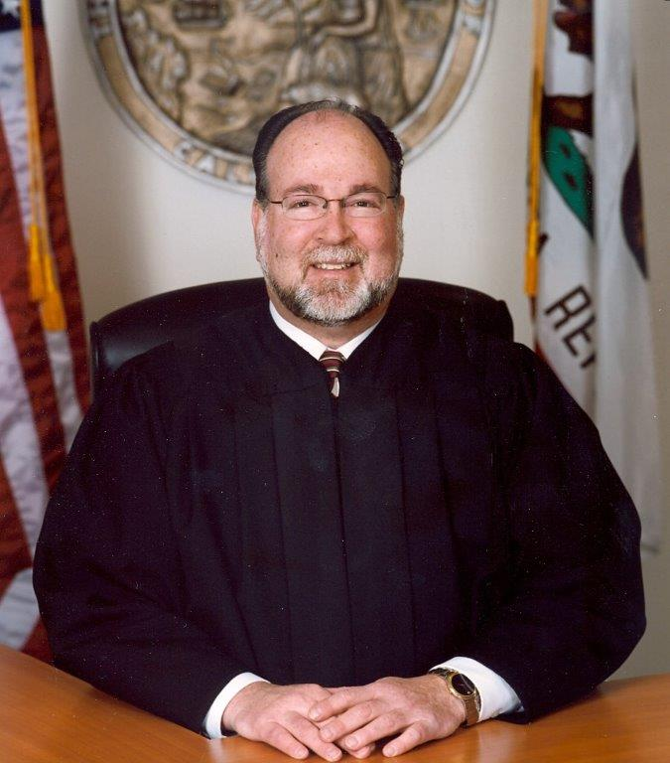
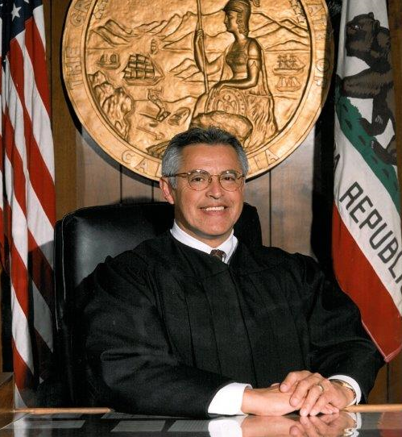
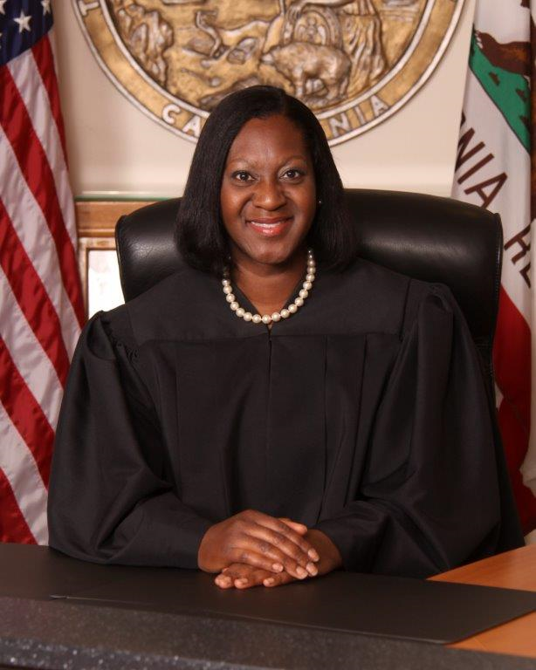
Committee Overview
Presiding Judge Michael A. Sachs
Judicial Sponsor
Judge John P. Pacheco
Co-Chair Elimination of Bias Committee
Judge Khymberli S. Apaloo
Co-Chair Elimination of Bias Committee
JCC Workgroup Presentation | May 4, 2021

Slide 3
Committee Overview
Why Form a Local Committee?
Pursuant to Judicial Administrative Standard 10.20(b)
As part of the international response to the death of George Floyd
Approached by Judge Apaloo
Nationwide and local protests
Compelled to address bias and racism within the justice system
Bring awareness
Address potential training needs, etc.
JCC Workgroup Presentation | May 4, 2021

Slide 4
Committee Overview
Who is on the Committee?
Chaired by Judge Pacheco and Judge Apaloo
11 judicial officers, from each department/location
4 staff members including Legal Counsel, Public Information Officer, Training Analyst and administrative support
4 attorneys from County including public defender, district attorney and county counsel
5 private practice attorneys, and 1 former past president of the local bar association
JCC Workgroup Presentation | May 4, 2021

Slide 5
Committee Overview
How were Committee Members Recruited?
Initial outreach began on July 31, 2020
Goal of a well-balanced committee with different perspectives and litigation areas of practice
Approached justice partners early on to gain buy-in
Direct outreach to members of the local bar association, and other legal associations & judicial officers
Additional outreach via social media and website
Interested applicants to submit a letter of intent explaining why they would like to join the committee
Committee appointments were made on October 16, 2020
JCC Workgroup Presentation | May 4, 2021

Slide 6
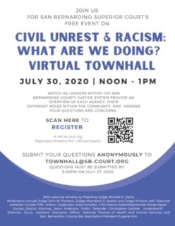
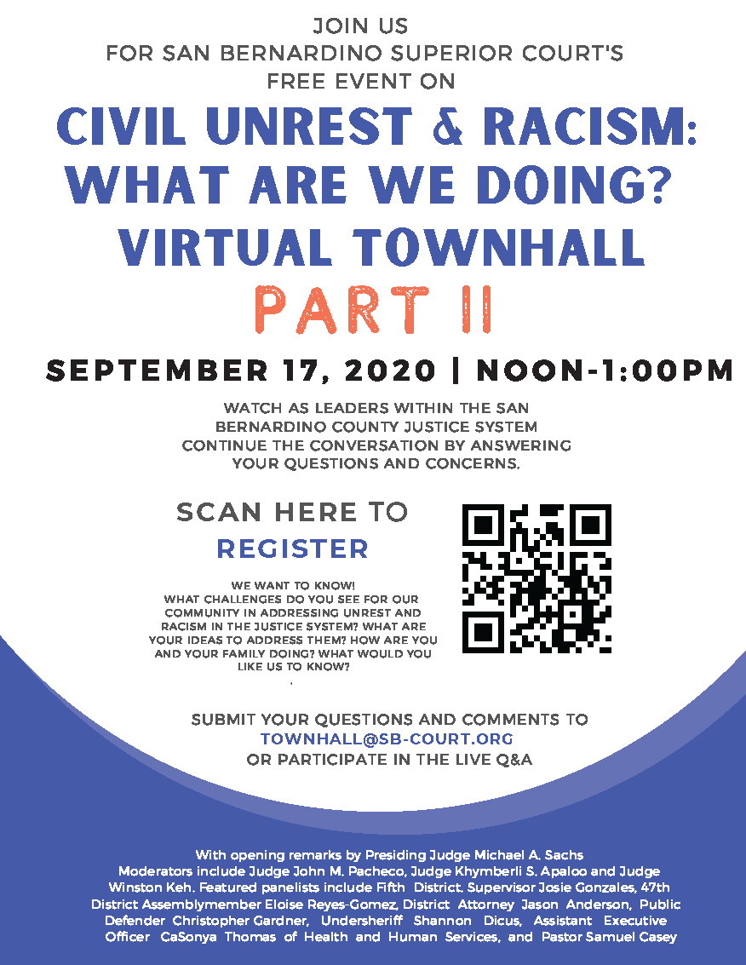
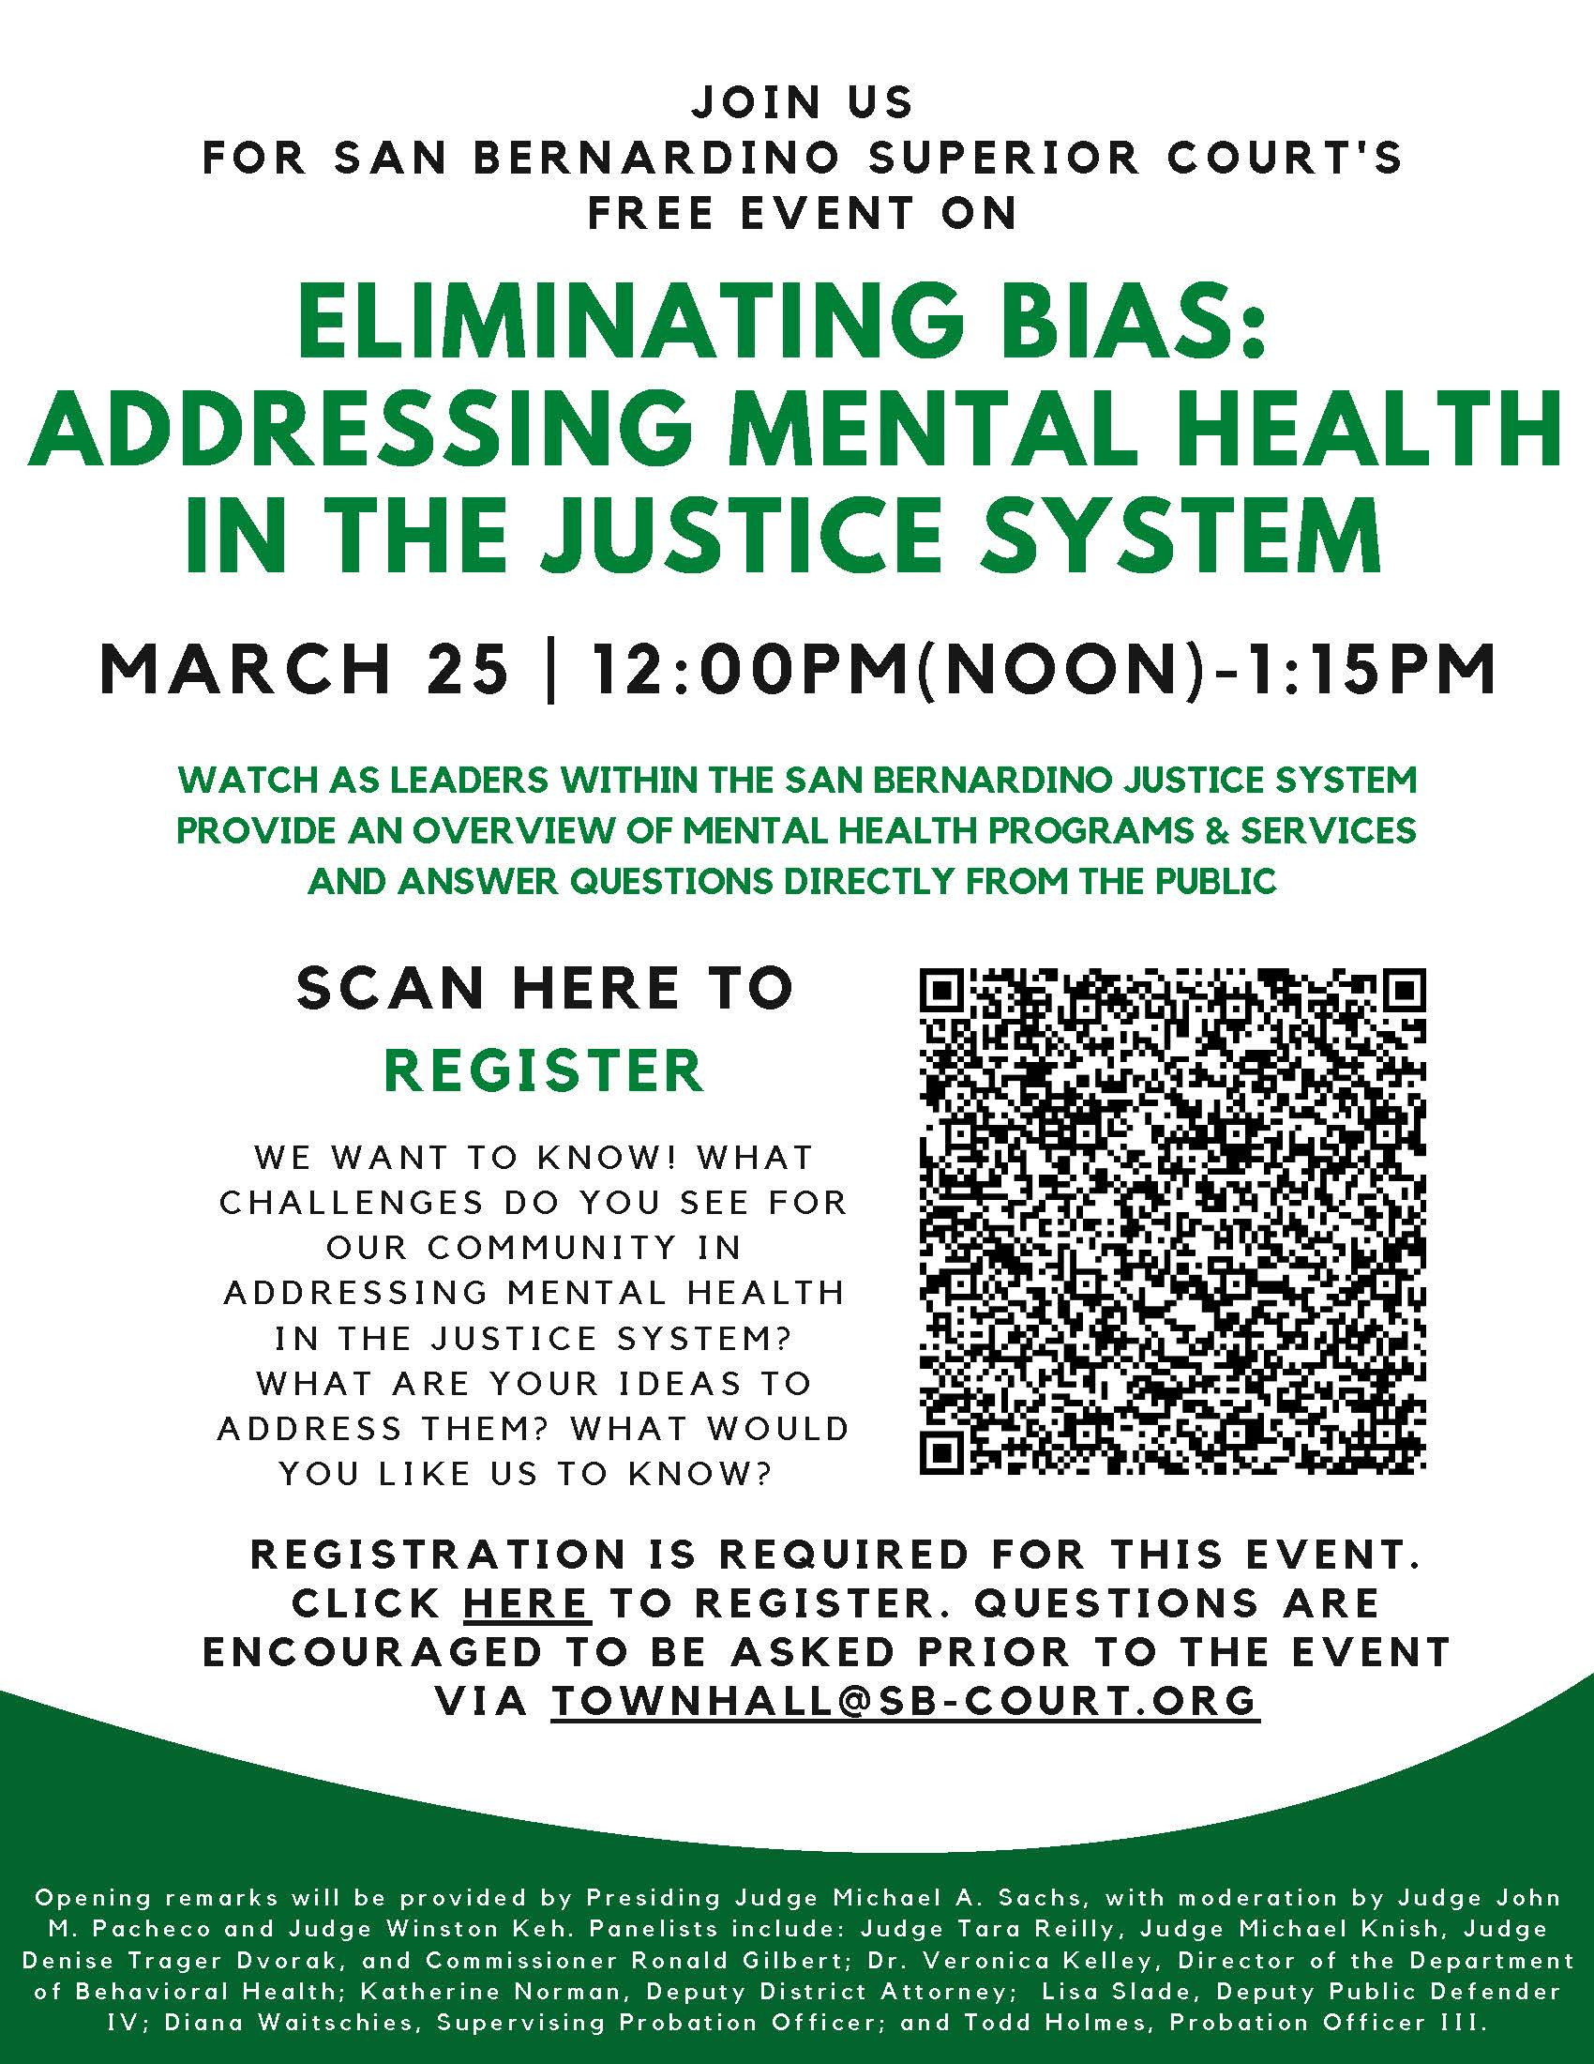
Committee Overview
Series of Townhalls on Racism and Eliminating Bias
JCC Workgroup Presentation | May 4, 2021
Notes:
Part of the community outreach committee efforts and started with townhall efforts addressing racism and bias.

Slide 7
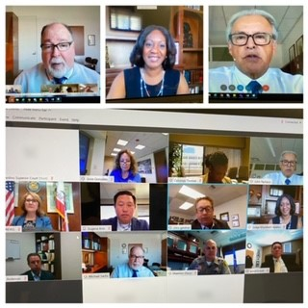
Committee Overview
Townhall Overview and Topics
Civil Unrest and Racism: What are we doing Now? held on July 30, 2020
Part II, held on September 17, 2020 continued the discussion on unrest and racism
Eliminating Bias: Addressing Mental Health in the Justice System held on March 25, 2021
JCC Workgroup Presentation | May 4, 2021
Notes:
Addressed working policies within each agency (pd, da, county counsel, hss, legislative perspectives), insight on how the public can contribute to policy
making, etc.
Stats included:
1ST Townhall: 258 registered
2nd Townhall: 188 registered
3rd Townhall: 297 registered

Slide 8
Committee Overview
Committee Activity to Date
10/28/20: Covered Introductions, Standard 10.20 and Aspen Institute Glossary for Understanding the Dismantling Structural Racism/Promoting Racial Equity Analysis
12/9/20: Covered focus and goals of the committee along with brainstorming of subcommittees
JCC Workgroup Presentation | May 4, 2021

Slide 9
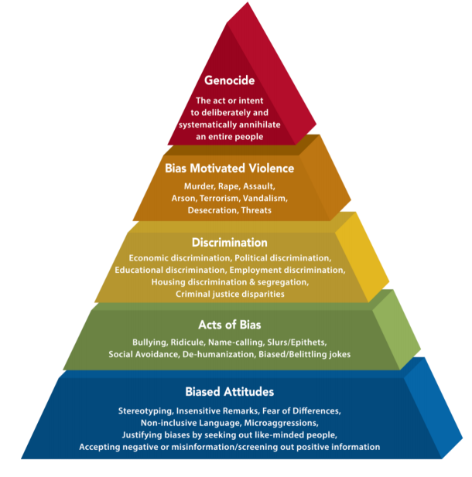
Committee Overview
Committee Activity to Date
2/3/21: Facilitated education session (pyramid of hate) exploring nature of bias, types of biases and sharing personal experiences in mini breakout sessions
JCC Workgroup Presentation | May 4, 2021

Slide 10
Committee Overview
Committee Activity to Date
3/30/21: Approved mission statement and formed subcommittees:
To foster a safe, educational environment within which issues and examples of bias and the effect of bias may be discussed, understood and resolved.
To encourage and promote full and equal participation of all members of our community in the Third Branch of our Government.
To educate and train our justice partners, including the Bar, Bench Officers and Court Staff, to understand, recognize and manage implicit biases thereby enabling our Court to provide equal access to justice and fairness in all its decision making.
JCC Workgroup Presentation | May 4, 2021

Slide 11
Committee Overview
Overview of Subcommittees:
Outreach
Education and Training
Rules, Policies and Procedures
Court Access and Eliminating the Justice Gap
JCC Workgroup Presentation | May 4, 2021
Notes:
Outreach
Explore and execute ways of obtaining data on stakeholder experiences of bias in the courts from various sources including the public, judicial officers and court personnel
Make public the efforts of the Committee as a whole and bring awareness to programs available
Supporting and mentoring young legal and court professionals in matters pertaining to bias and equal access
Education and Training
Educate judicial officers, court personnel, juries, attorneys and the public on elimination of bias in the justice system
Rules, Policies and Procedures
Develop rules, policies and procedures for the Complaints Review process and other issues that may present themselves
Court Access and Eliminating the Justice Gap
Explore ways to make court processes more accessible and equitable for those of varied socioeconomic backgrounds and ability levels

Slide 12
Committee Overview
Lessons Learned and Insights
Resiliency
Committee takes a long time to form and get going
Balance committee with different perspectives
Consider a baseline understanding first
Establishing a common understanding is a benefit
Technology is your friend
Lunch time works best for meetings
JCC Workgroup Presentation | May 4, 2021

Slide 13
Committee Overview
JCC Workgroup Presentation | May 4, 2021

Slide 14
SUPERIOR COURT OF CALIFORNIA, COUNTY OF SAN BERNARDINO
Thank you!

