Slide 1
Judicial Branch Workers’ Compensation Program
Advisory Committee Meeting
November 4, 2015

Slide 2
Agenda
Arrival
Call to Order; Roll Call; Opening Remarks
  Approval of Minutes (Action)
Written Comment
Discussion and Possible Action Items
  Orientation for New Members of the JBWCP Advisory Committee – Roles and Responsibilities of Committee Members (Information)
  Program Overview and History of the JBWCP (Information)

Slide 3
Agenda cont.
Lunch
  Life Cycle of a Workers Compensation Claim (Information)
  Consideration for Program Settlement Guidelines (Action)
  Program Funding (Information)

Slide 4
Agenda cont.
  Consideration for Next Steps Towards Fully Funding (Action)
  Consideration for Renewal of JBWCP Service Contracts (Action)
  Development of the Annual Meeting Agenda (Action)
Adjourn

Slide 5
Call to Order, Roll Call, Opening Remarks

Slide 6
Advisory Committee
Tania Ugrin-Capobianco, Chair, El Dorado County Superior Court
Jeanine Bean, Stanislaus County Superior Court
Colette Bruggman, Court of Appeal, Third Appellate District
Heather Capps, Orange County Superior Court
Hon. Wynne S. Carvill, Alameda County Superior Court
Stephanie Cvitkovich, San Diego County Superior Court
Tammy Grimm, Imperial County Superior Court
Michele Hafner, Fresno County Superior Court
Cindia Martinez, Sonoma County Superior Court
Shannon Stone, Contra Costa County Superior Court
Brian Taylor, Solano County Superior Court
Christina Volkers, San Bernardino County Superior Court
T. Michael Yuen, San Francisco County Superior Court
David H. Yamasaki, Santa Clara County Superior Court

Slide 7
Also Attending
Judicial Council Staff - JBWCP Program Administration
Program Consultant - Bickmore
Claims Administration - Acclamation Insurance Management Services

Slide 8
Approval of Minutes

Slide 9
Written Comments
This time is reserved to address written comments submitted by members of the public to the Committee.

Slide 10
Orientation for
New Members of the JBWCP Advisory Committee – Roles and Responsibilities
Presenter: Tania Ugrin-Capobianco, Chair
Facilitator: Linda Cox, Program Administrator

Slide 11
JBWCP Advisory Committee Charge:
Determine JBWCP priorities and initiatives, and ensure results through outreach and collaboration;
Oversee all program vendors to promote administrative efficiency;
Provide financial stewardship to ensure adequate funding for the program through the use of annual actuarial loss projections and consistent application of premium/cost allocation to all program participants.

Slide 12
The JBWCP Advisory Committee Charge Cont:
Ensure the timely and accurate adjudication of claims;
Implement the necessary procedures to obtain appropriate treatment and return injured workers to gainful employment as soon as they are able;
Develop useful resources, tools, and procedures for the program participants to ensure efficient and effective claims monitoring;
Identify trends and mitigation opportunities to contain costs and manage outcomes.

Slide 13
Program Overview and History of the JBWCP
Presenter: Tania Ugrin-Capobianco, Chair
Facilitator: Linda Cox, Program Administrator

Slide 14
California Rules of Court
10.67 Judicial Branch Advisory Committee
Effective January 1, 2015
(a) Area of focus
The committee makes recommendations to the council for improving the statewide administration of the Judicial Branch Workers' Compensation Program and on allocations to and from the Judicial Branch Workers' Compensation Fund established under Government Code section 68114.10.
(b) Additional duties
In addition to the duties specified in rule 10.34, the committee must review:
  (1) The progress of the Judicial Branch Workers' Compensation Program;
  (2) The annual actuarial report; and
  (3) The annual allocation, including any changes to existing methodologies for allocating workers' compensation costs.
The advisory committee consists of persons from trial courts and state judicial branch entities knowledgeable about workers' compensation matters, including court executive officers, appellate court clerk/administrators, and human resources professionals.

Slide 15
Relevant Legislative Mandates
Rule 10.350. Workers’ compensation program
Rule 10.67. Judicial Branch Workers’ Compensation Advisory Committee
Rule 10.11. Executive and Planning Committee
California Government Code Section 68114.10
Labor Code Section 3700
California Government Code Section 71623.5

Slide 16
Life Cycle of a Workers’ Compensation Claim
Presenter: Jacquelyn Miller, Bickmore
Presenter: Patrick Fuleihan, AIMS
Facilitator: Linda Cox, Program Administrator

Slide 17

Life Of A Claim
Maintain a safe workplace
Post Accident Investigation
Offer of work
DWC1 and NOPE – 1 Day
Applicant QME / P&S
File Declaration of Readiness to Proceed
Identify/correct unsafe conditions
$10,000 Med Treatment / UR/IMR
Sub rosa/Investigations
Develop Settlement
Close File
Injury Reported to I TPA – 5 Days
Designated Medical Clinic
Assign to a Defense Attorney
End TD
Attend Settlement Conference
Injury Reported to Employer
TPA sets up claim
Initial Investigation – 14 Days
AME Consideration
Request Settlement Authority
Continued Investigation
Provide Med Treatment / UR/IMR
Notice of Rep/Attorney Notice
Pay Final Benefits and Bills
Panel QME
Independent Medical Review
Discuss settlement offer revision
Delay – 90 Days
Pay TD
Medical Care Dispute
Defense QME / P&S/RTW
Reserves
New Doctor
Case Resolution
Accept
Offer to Settle
Deposition
Approximately Two Years

Slide 18
Life Of A Claim
Maintain a Safe Workplace
Maintain a safe workplace
Post Accident Investigation
Offer of work
DWC1 and NOPE – 1 Day
Applicant QME / P&S
File Declaration of Readiness to Proceed
Identify/correct unsafe conditions
$10,000 Med Treatment / UR/IMR
Sub rosa/Investigations
Develop Settlement
Close File
Injury Reported to I TPA – 5 Days
Designated Medical Clinic
Assign to a Defense Attorney
End TD
Attend Settlement Conference
Injury Reported to Employer
TPA sets up claim
Initial Investigation – 14 Days
AME Consideration
Request Settlement Authority
Identify Unsafe Conditions
Continued Investigation
Provide Med Treatment / UR/IMR
Notice of Rep/Attorney Notice
Pay Final Benefits and Bills
Panel QME
Independent Medical Review
Discuss settlement offer revision
Delay – 90 Days
Pay TD
Medical Care Dispute
Defense QME / P&S/RTW
Reserves
New Doctor
Case Resolution
Accept
Offer to Settle
Post Accident Identification
Deposition
Approximately Two Years

Slide 19
Life Of A Claim
Post Accident Investigation
Maintain a safe workplace
DWC1 Provided
Offer of work
DWC1 and NOPE – 1 Day
Applicant QME / P&S
File Declaration of Readiness to Proceed
Identify/correct unsafe conditions
$10,000 Med Treatment / UR/IMR
Sub rosa/Investigations
Develop Settlement
Close File
Injury Reported to I TPA – 5 Days
Designated Medical Clinic
Assign to a Defense Attorney
End TD
Attend Settlement Conference
Injury Reported to Employer
TPA sets up claim
Initial Investigation – 14 Days
AME Consideration
Request Settlement Authority
Continued Investigation
Designated Medical Clinic
Provide Med Treatment / UR/IMR
Notice of Rep/Attorney Notice
Pay Final Benefits and Bills
Panel QME
Independent Medical Review
Discuss settlement offer revision
Delay – 90 Days
Pay TD
Medical Care Dispute
Defense QME / P&S/RTW
Reserves
New Doctor
Case Resolution
Injury Reported to TPA/AIMS
Offer to Settle
Accept
Deposition
Approximately Two Years

Slide 20
Life Of A Claim
Post Accident Investigation
Delay to Investigate
Maintain a safe workplace
Offer of work
DWC1 and NOPE – 1 Day
Applicant QME / P&S
File Declaration of Readiness to Proceed
Identify/correct unsafe conditions
$10,000 Med Treatment / UR/IMR
Sub rosa/Investigations
Develop Settlement
Close File
Injury Reported to I TPA – 5 Days
Designated Medical Clinic
Assign to a Defense Attorney
End TD
Attend Settlement Conference
Injury Reported to Employer
TPA sets up claim
Initial Investigation – 14 Days
AME Consideration
Request Settlement Authority
Continued Investigation
Panel QME (Eval)
Provide Med Treatment / UR/IMR
Notice of Rep/Attorney Notice
Pay Final Benefits and Bills
Panel QME
Independent Medical Review
Discuss settlement offer revision
Delay – 90 Days
Pay TD
Medical Care Dispute
Defense QME / P&S/RTW
Reserves
New Doctor
Case Resolution
Accept
Offer to Settle
Final Decision
Deposition
Approximately Two Years

Slide 21
Life Of A Claim
Pay TD
Maintain a safe workplace
Post Accident Investigation
Provide Medical Care/UR
Offer of work
DWC1 and NOPE – 1 Day
Applicant QME / P&S
File Declaration of Readiness to Proceed
Identify/correct unsafe conditions
$10,000 Med Treatment / UR/IMR
Sub rosa/Investigations
Develop Settlement
Close File
Injury Reported to I TPA – 5 Days
Designated Medical Clinic
Assign to a Defense Attorney
End TD
Attend Settlement Conference
Injury Reported to Employer
TPA sets up claim
Initial Investigation – 14 Days
AME Consideration
Request Settlement Authority
Continued Investigation
Provide Med Treatment / UR/IMR
Notice of Rep/Attorney Notice
Pay Final Benefits and Bills
Panel QME
Independent Medical Review
Discuss settlement offer revision
Delay – 90 Days
Pay TD
Medical Care Dispute
Defense QME / P&S/RTW
Notice of Representation
Reserves
New Doctor
Case Resolution
Accept
Offer to Settle
Deposition
Approximately Two Years

Slide 22

Life Of A Claim
WHEN THE CLAIM TAKES ON A LIFE OF ITS OWN!
Maintain a safe workplace
Post Accident Investigation
Offer of work
DWC1 and NOPE – 1 Day
Applicant QME / P&S
File Declaration of Readiness to Proceed
Identify/correct unsafe conditions
$10,000 Med Treatment / UR/IMR
Sub rosa/Investigations
Develop Settlement
Close File
Injury Reported to I TPA – 5 Days
Designated Medical Clinic
Assign to a Defense Attorney
End TD
Attend Settlement Conference
Injury Reported to Employer
TPA sets up claim
Initial Investigation – 14 Days
AME Consideration
Request Settlement Authority
Continued Investigation
Provide Med Treatment / UR/IMR
Notice of Rep/Attorney Notice
Pay Final Benefits and Bills
Independent Medical Review
Discuss settlement offer revision
A Discussion of circumstances that delay a claim.
Delay – 90 Days
Panel QME
Pay TD
Medical Care Dispute
Defense QME / P&S/RTW
Reserves
New Doctor
Case Resolution
Accept
Offer to Settle
Deposition
DELAYED REPORTING BY EMPLOYEE
DELAYS
UNCOOPERATIVE EMPLOYEE
DELAYED REPORTING TO TPA
SETTLEMENT NEGOTIATIONS
LACK OF COOPERATION W/INVESTIGATION
CONFLICTING MEDICAL OPINIONS
SURGERY REQUESTED/REQUIRED
SETTLEMENT AUTHORITY DELAYS – ADDITIONAL INFORMATION NEEDED
LITIGATION
DOCTOR FAILS TO REPORT

Slide 23
Life Of A Claim
New Doctor
Maintain a safe workplace
Post Accident Investigation
Assign Defense Attorney
Offer of work
DWC1 and NOPE – 1 Day
Applicant QME / P&S
File Declaration of Readiness to Proceed
Identify/correct unsafe conditions
$10,000 Med Treatment / UR/IMR
Sub rosa/Investigations
Develop Settlement
Close File
Injury Reported to I TPA – 5 Days
Designated Medical Clinic
Investigation/
Sub rosa
Injury Reported to Employer
TPA sets up claim
Assign to a Defense Attorney
End TD
Attend Settlement Conference
Initial Investigation – 14 Days
AME Consideration
Request Settlement Authority
Continued Investigation
Provide Med Treatment / UR/IMR
Notice of Rep/Attorney Notice
Pay Final Benefits and Bills
Panel QME
Independent Medical Review
Discuss settlement offer revision
Delay – 90 Days
Pay TD
Medical Care Dispute
Defense QME / P&S/RTW
New Doctor
Case Resolution
Reserves
Accept
Depositions
Offer to Settle
Deposition
Approximately Two Years

Slide 24
Life Of A Claim
Medical/Legal Evaluations
Maintain a safe workplace
Post Accident Investigation
Offer of work
Applicant QME / P&S
DWC1 and NOPE – 1 Day
Permanent and Stationary/MMI
File Declaration of Readiness to Proceed
Identify/correct unsafe conditions
$10,000 Med Treatment / UR/IMR
Sub rosa/Investigations
Develop Settlement
Close File
Injury Reported to I TPA – 5 Days
Designated Medical Clinic
Assign to a Defense Attorney
End TD
Attend Settlement Conference
Injury Reported to Employer
TPA sets up claim
Initial Investigation – 14 Days
AME Consideration
Request Settlement Authority
Continued Investigation
Provide Med Treatment / UR/IMR
Notice of Rep/Attorney Notice
Pay Final Benefits and Bills
Panel QME
Independent Medical Review
Discuss settlement offer revision
Delay – 90 Days
Pay TD
Medical Care Dispute
Defense QME / P&S/RTW
New Doctor
Release to Return to Work
Case Resolution
Reserves
Accept
Offer to Settle
Deposition
Approximately Two Years

Slide 25
Life Of A Claim
Offer of Work
Maintain a safe workplace
Post Accident Investigation
Develop Settlement
Offer of work
DWC1 and NOPE – 1 Day
Applicant QME / P&S
File Declaration of Readiness to Proceed
Sub rosa/Investigations
Develop Settlement
Close File
Identify/correct unsafe conditions
$10,000 Med Treatment / UR/IMR
Request Settlement Authority
Injury Reported to I TPA – 5 Days
Designated Medical Clinic
Assign to a Defense Attorney
End TD
Attend Settlement Conference
Injury Reported to Employer
TPA sets up claim
Initial Investigation – 14 Days
AME Consideration
Request Settlement Authority
Continued Investigation
Provide Med Treatment / UR/IMR
Notice of Rep/Attorney Notice
Pay Final Benefits and Bills
Panel QME
Independent Medical Review
Discuss settlement offer revision
Delay – 90 Days
Pay TD
Medical Care Dispute
Defense QME / P&S/RTW
Reserves
New Doctor
Case Resolution
Accept
Offer to Settle
Deposition
Offer to Settle
Approximately Two Years

Slide 26
Life Of A Claim
Post Accident Investigation
Settlement Negotiation and/or Conference
Maintain a safe workplace
Offer of work
DWC1 and NOPE – 1 Day
Applicant QME / P&S
File Declaration of Readiness to Proceed
Identify/correct unsafe conditions
$10,000 Med Treatment / UR/IMR
Sub rosa/Investigations
Develop Settlement
Close File
Injury Reported to I TPA – 5 Days
Designated Medical Clinic
Assign to a Defense Attorney
End TD
Attend Settlement Conference
Injury Reported to Employer
TPA sets up claim
Initial Investigation – 14 Days
AME Consideration
Request Settlement Authority
Continued Investigation
Possible Revised Settlement Offer
Provide Med Treatment / UR/IMR
Notice of Rep/Attorney Notice
Pay Final Benefits and Bills
Panel QME
Independent Medical Review
Discuss settlement offer revision
Delay – 90 Days
Pay TD
Medical Care Dispute
Defense QME / P&S/RTW
Reserves
New Doctor
Case Resolution
Accept
Offer to Settle
Deposition
Case Resolution
Approximately Two Years

Slide 27
Life Of A Claim
CASE RESOLVED
CLOSED - NO FURTHER BENEFITS ARE DUE
Maintain a safe workplace
Post Accident Investigation
Offer of work
DWC1 and NOPE – 1 Day
Applicant QME / P&S
File Declaration of Readiness to Proceed
Identify/correct unsafe conditions
$10,000 Med Treatment / UR/IMR
Sub rosa/Investigations
Develop Settlement
Close File
Injury Reported to I TPA – 5 Days
Designated Medical Clinic
Assign to a Defense Attorney
End TD
Attend Settlement Conference
Injury Reported to Employer
TPA sets up claim
Initial Investigation – 14 Days
AME Consideration
Request Settlement Authority
Continued Investigation
Provide Med Treatment / UR/IMR
Notice of Rep/Attorney Notice
Pay Final Benefits and Bills
Panel QME
Independent Medical Review
Discuss settlement offer revision
Delay – 90 Days
Pay TD
Medical Care Dispute
Defense QME / P&S/RTW
Reserves
New Doctor
Case Resolution
Accept
Offer to Settle
Deposition
Approximately Two Years

Slide 28
Consideration for Program Settlement Authority Guidelines
Presenter: Jacquelyn Miller, Bickmore
Presenter: Patrick Fuleihan, AIMS
Facilitator: Linda Cox, Program Administrator

Slide 29
Settlement Authority
Workers’ compensation settlements can be very complex.
Varied WC experience and knowledge
Different settlement approval processes.
Prompt settlement approval can reduce litigation exposure.

Slide 30
Basic Settlement Types
Compromise and Release:
Potential lump sum settlement
May involve Medicare
May resolve the claim completely
Stipulated Award:
Generally Paid over time
May leave medical care open
May resolve only part of the claim

Slide 31
Settlement Process
10/1/2014 – 9/30/2015
30 Compromise and Release Settlements
32 Stipulated Award/Findings and Awards

Slide 32
Uniform Settlement Process
Benefits
Assures consistency throughout the JBWCP
Establishes timelines for review and approval
Clarifies settlement authority

Slide 33
Uniform Settlement Process
Considerations
What will be accomplished?
What training will be required?
How will we know if it is successful
How will this impact members?

Slide 34
Uniform Settlement Process
Next Steps
Who decides what the criteria will be?
What information do you need to set the criteria?
How will the process work?
How do other “pooled” programs handle settlements?

Slide 35
Program Funding
Presenter: Michael Harrington, Bickmore
Facilitator: Linda Cox, Program Administrator

Slide 36

Annual
Actuarial Report
Michael Harrington, Bickmore

Slide 37


2015-16 Actuarial Report
Brief Review of Terminology
Outstanding Liabilities at June 30, 2015
  a.k.a. Reserves
2015-16 Funding Guidelines
  a.k.a. Rates
  But first…

Slide 38

Actuarial Science = Excitement!

Slide 39
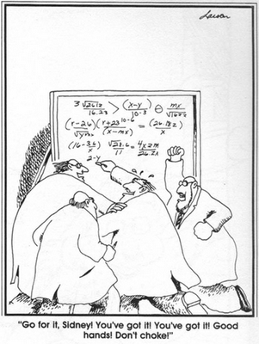
The Thrill of Victory

Slide 40
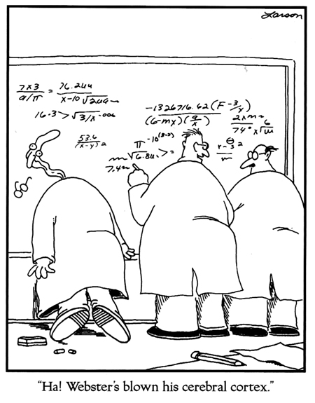
…and the Agony of Defeat

Slide 41
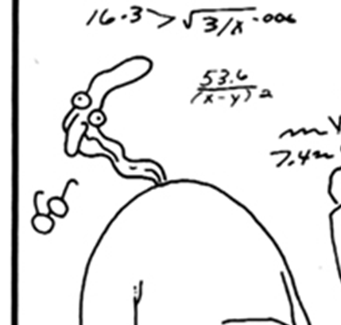
Too Much Excitement…

Slide 42
The Lingo
  Loss – Medical/Indemnity for WC
  ALAE – Allocated Loss Adjustment Expenses, which consist primarily of legal fees, usually analyzed together with loss
  ULAE – Unallocated Loss Adjustment Expenses, which consist primarily of claims administration expenses (in-house or TPA), usually analyzed separately from loss
42

Slide 43

Ultimate Loss
Ultimate Loss is the total cost of
claims occurring in a given year
Components of Ultimate Loss
    = Paid Loss
      The Accountant’s Number
    + Case Reserves
      The Adjuster’s Number
    + IBNR (Incurred But Not Reported) Reserves
      The Actuary’s Number

Slide 44
Reserves
Reserves are the amounts remaining
to be paid on claims occurring in a
given year
Also called outstanding liabilities
Reserves = Case Reserves + IBNR Reserves
    Or…
Reserves = Ultimate Losses – Paid Losses

Slide 45
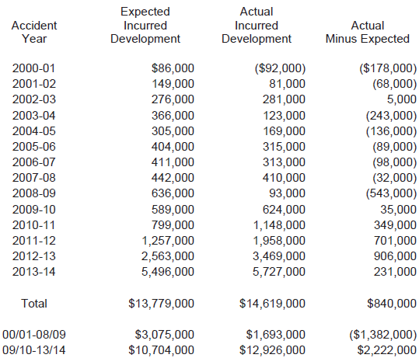
Loss Development – Trial Courts
Incurred
Losses
Development from
12/31/13
to
12/31/14

Slide 46
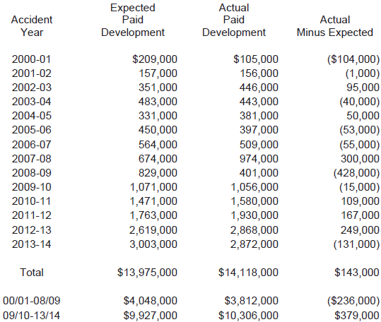
Loss Development – Trial Courts
Paid
Losses
Development from
12/31/13
to
12/31/14

Slide 47
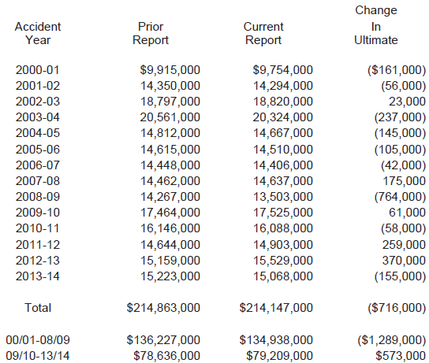
Ultimate Loss – Trial Courts

Slide 48
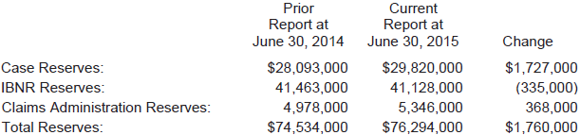

Liabilities – Trial Courts
Comparison of June 30 Projections…

Slide 49
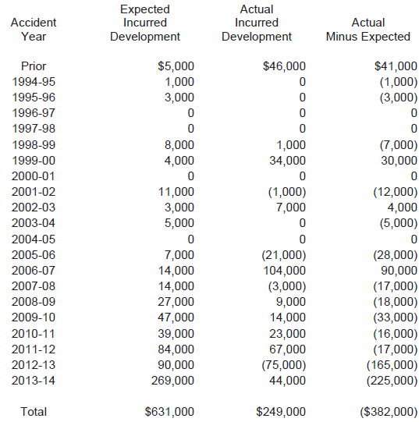
Loss Development – Judiciary
Incurred
Losses
Development from
12/31/13
to
12/31/14

Slide 50
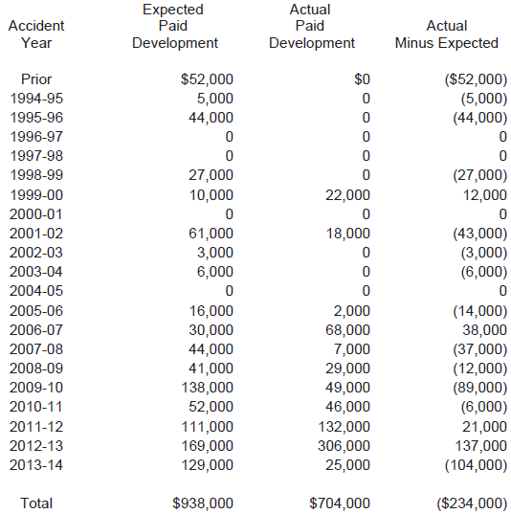
Loss Development – Judiciary
Paid
Losses
Development from
12/31/13
to
12/31/14

Slide 51
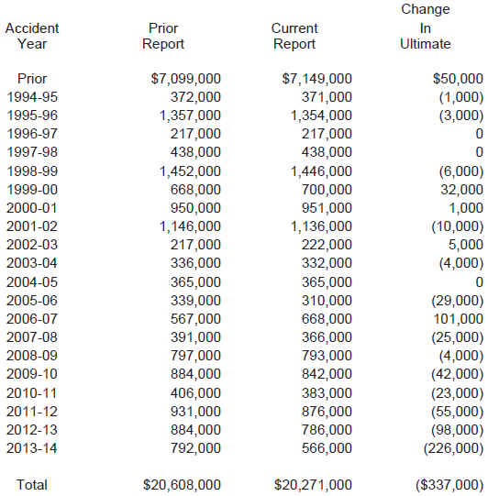
Ultimate Loss – Judiciary

Slide 52
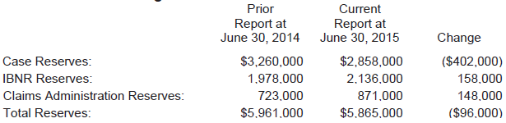
Liabilities – Judiciary
Comparison of June 30 Projections…

Slide 53
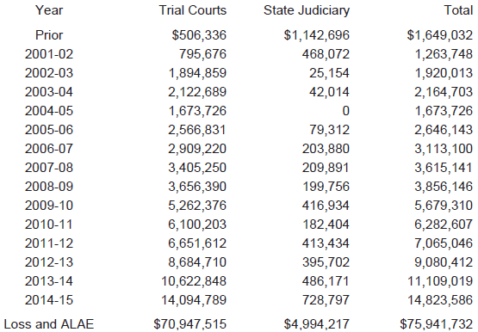
Outstanding Liabilities at 6/30/15
As of June 30, loss and ALAE by year…

Slide 54

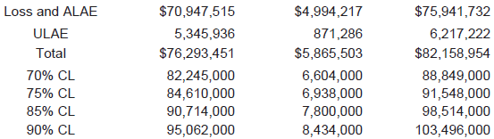
Outstanding Liabilities at 6/30/15
As of June 30, Adding ULAE and Confidence Levels…
Confidence levels reflect variability of outstanding liabilities

Slide 55
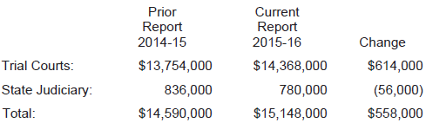
Projected Paid Loss & ALAE
For 2015-16
Amounts paid between 7/1/15 and 6/30/16 for all claims…

Slide 56
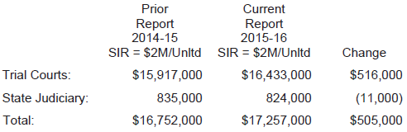
Projected Ultimate Loss & ALAE
For 2015-16
Ultimate for new claims occurring between 7/1/15 and 6/30/16…

Slide 57

Member Premium
Allocations
Michael Harrington, Bickmore

Slide 58
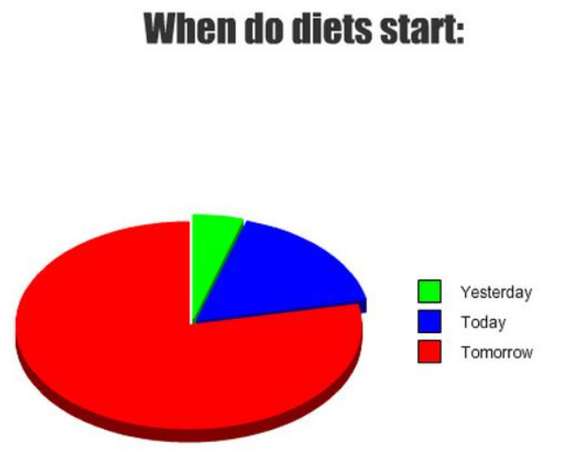


Pie Charts - Health

Slide 59
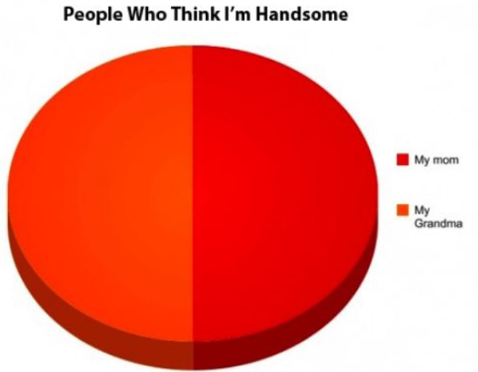
Pie Charts - Beauty

Slide 60
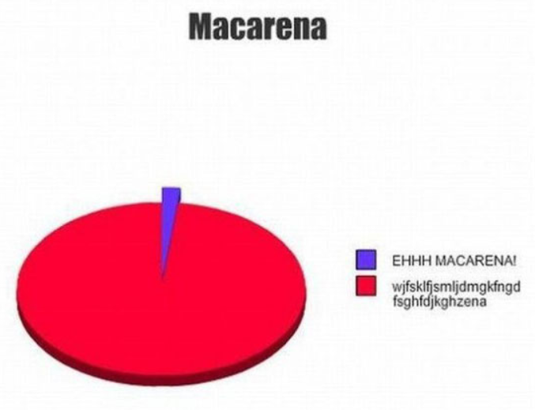
Pie Charts - Music

Slide 61


2015-16 Allocation
How do we divide up the program cost between courts?
% of Total Losses
% of Total Payrolls

Slide 62
Costs To Allocate - Total
  Ultimate Loss and ALAE
    $17,257,000 (from actuarial study)
  Third-Party Claims Administration Fees
    $2,250,000
  Excess Insurance Premiums
    $655,029
  Consulting and Brokerage Expenses
    $465,591
  Total
    $20,627,620

Slide 63
Costs To Allocate – Trial Courts
  Ultimate Loss and ALAE
    $16,433,000 (from actuarial study)
  Third-Party Claims Administration Fees
    $2,016,805 (89.6% of Total)
  Excess Insurance Premiums
    $480,114 (73.3% of Total)
  Consulting and Brokerage Expenses
    $417,336 (89.6% of Total)
  Total
    $19,347,255

Slide 64
Costs To Allocate – Judiciary
  Ultimate Loss and ALAE
    $824,000 (from actuarial study)
  Third-Party Claims Administration Fees
    $233,195 (10.4% of Total)
  Excess Insurance Premiums
    $174,915 (26.7% of Total)
  Consulting and Brokerage Expenses
    $48,255 (10.4% of Total)
  Total
    $1,280,366

Slide 65
Loss Allocation Methodology
  For each court…
  Determine 3-Year Incurred Losses % of Total
      Losses capped at $75,000 per claim
  Determine 3-Year Payroll % of Total
  Determine Loss Weight
      80% to Largest Court
      Smaller Courts receive less weight
  % Allocation = (% Capped Losses) x (Loss Weight)
  + (% Payroll) x (1.0 – Loss Weight)

Slide 66
Expense Allocation Methodology
  For each court…
  Excess Insurance Premiums are allocated based upon % of Total Payroll
  Both TPA Fees and Consulting/Brokerage Fees are allocated giving 80% weight to % of Total Capped Losses and 20% weight to % of Total payroll

Slide 67
Documents For Members
  For each court, a document will be provided that includes the following…
  Memo describing the cost allocation methodology
  Coverage declaration page
  Detailed calculation of the premium allocation
  Comparison with prior allocation
  Allocation training to come

Slide 68
Program Funding
Michael Harrington, Bickmore
Gregory Trout, Bickmore
Linda Cox, JBWCP Program Administrator

Slide 69
Program Status
  Over the years, cash flow funding has resulted in a deficit between program assets and program liabilities:
  Program Liabilities are approximately $82 million.
  Program Assets are approximately $51 million.
    ➔ The program is strongly funded to cover all projected short-term cash flow scenarios, but is not fully funded for the long-term.
  Program Funding Goals:
  Short-Term – To prevent gap from growing
  Long-Term – Eliminate gap and fully-fund program

Slide 70
Funding Options
  There are two basic methods for funding self-insurance programs…
  Cash Flow Funding – Charges premiums to cover the cost of claims paid in a given fiscal year.
  Ultimate Cost Funding – Charges premiums to cover the ultimate cost of claims occurring in a given fiscal year.

Slide 71
Funding Options
  There are two basic methods for funding self-insurance programs…
  Cash Flow Funding – Charges premiums to cover the cost of claims paid in a given fiscal year.
  Ultimate Cost Funding – Charges premiums to cover the ultimate cost of claims occurring in a given fiscal year.

Slide 72
Funding Options
  There are two basic methods for funding self-insurance programs…
  Cash Flow Funding – Charges premiums to cover the cost of claims paid in a given fiscal year.
  Ultimate Cost Funding – Charges premiums to cover the ultimate cost of claims occurring in a given fiscal year.
Previous Method

Slide 73
Funding Options
  There are two basic methods for funding self-insurance programs…
  Cash Flow Funding – Charges premiums to cover the cost of claims paid in a given fiscal year.
  Ultimate Cost Funding – Charges premiums to cover the ultimate cost of claims occurring in a given fiscal year.
New Method

Slide 74
Excess Insurance Coverage
  Previously only the Trial Courts had excess coverage.
  This year we have been able to secure an excess coverage option for the Judiciary at the same rate as the Trial Courts:
  Similar to Trial Courts, this would cap the Judiciary’s exposure to loss from a single occurrence to $2M.
  Additional net cost would be approximately $159K.
    Savings of $16K in self-insured loss and ALAE
    Cost of $175 for excess insurance premium

Slide 75
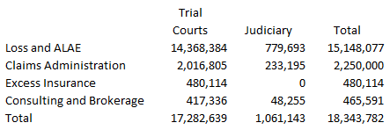
Total Cash Flow Funding
For 2015-16
Amounts paid between 7/1/15 and 6/30/16 for all claims…
+$0.7M

Slide 76
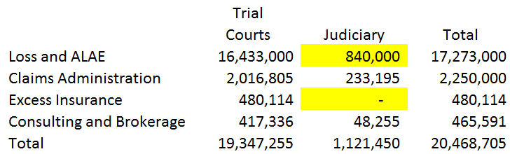
Total Ultimate Funding
For 2015-16
Ultimate for new claims occurring between 7/1/15 and 6/30/16…
+$2.1M

Slide 77
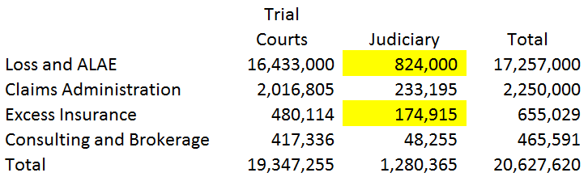
Total Ultimate Funding
For 2015-16
** With Judiciary Purchasing Excess Insurance **
Ultimate for new claims occurring between 7/1/15 and 6/30/16…
+$159K

Slide 78
Summary
  The change to ultimate cost funding achieves the program’s short-term funding goal of preventing the deficit between assets and liabilities from growing.
    Cash flow funding increase for 2015-16 is $0.7M.
    Ultimate cost funding adds an additional $2.1M.
  The purchase of excess insurance will protect the assets of the program from large shock losses.
    This adds $159K to 2015-16 Judiciary premium.

Slide 79
Consideration for Next Steps Towards Fully funding the JBWCP
Presenter: Tania Ugrin-Capobianco, Chair
Presenter: Gregory Trout, Bickmore
Presenter: Michael Harrington, Bickmore
Facilitator: Linda Cox, Program Administrator

Slide 80
Next Steps
  The change to ultimate cost funding this year addressed the goal of preventing the deficit from growing, but doesn’t decrease the deficit.
  The next item to consider is reducing the deficit to zero and fully funding the program.
  If implemented, it will take a multi-year approach to ultimately achieve the full funding goal.

Slide 81
Why Full Funding?
  Standard best practice for self-insurance programs
  Accepted practice for enterprise funds
  Proper presentation of financial statements
  Stigma of Reporting “unfunded liability” to State
  Program Flexibility
  Catastrophic Claim Exposure
  Not Kicking Can Down the Road for Future Generations
  You Don’t Want to be left holding the bag if others leave

Slide 82
Full Funding Considerations
  Premium Impact
  Methodology
  Timing

Slide 83

Questions ??

Slide 84
Consideration for Renewal of JBWCP Service Contracts
Presenter: Linda Cox, Program Administrator

Slide 85
Development of the Annual Meeting Agenda and Discussion on Frequency of Meetings
Presenter: Tania Ugrin-Capobianco, Chair
Presenter: Linda Cox, Program Administrator

