Slide 1
Court Ordered Debt: Performance measures & Benchmarks Judicial Council, Budget services February 2022
Notes:
Our presentation today is about the performance measures and benchmarks for collection activities.
Our focus is on delinquent court ordered debt – we will provide some background on that in the next slide.
Our presentation will explain why the Judicial Council is required to establish performance measures and benchmarks, Why the existing performance measures and benchmarks are no longer sufficient, the path in which we took to develop the proposed benchmarks, and lastly, we will walk through the individual PMB’s and what they indicate.

Slide 2
Delinquent Court Ordered Debt
Court-ordered debt can be processed by one or more of these programs:
58 court/county programs
13 private collection agencies
2 Franchise Tax Board programs (COD and IIC)
2 Intra-branch programs (Ventura Court, Shasta Court)
Until paid in full or discharged from accountability deemed uncollectible
Notes:
Once a citation is issued, which results in a court-ordered fine amount, the citation is either paid forthwith (on-time) or if not paid becomes delinquent.
An account becomes delinquent the day after the due date, and once delinquent – always delinquent. Delinquency triggers the court-ordered debt process, debt is actively pursued until paid in full, resolved by other means or taken off the books through the discharge process.
As required by law, the 58 court/county collections programs work collaboratively to collect and report on delinquent debt per PC section 1463.010. This code section also requires reporting data on a JCC approved template, which you will hear more about later.

Slide 3
Performance Measures and Benchmarks (PMB)
Why are PMBs needed?
How were PMBs developed?
Proposed PMBs
Notes:
You may be asking why is the JC evaluating Performance Measures and Benchmarks.
The answer is simple – we are required to by statute – PC 1463.010 (c) The Judicial Council shall develop performance measures and benchmarks to review the effectiveness of the cooperative superior court and county collection programs operating pursuant to this section. Each superior court and county shall jointly report to the Judicial Council, as provided by the Judicial Council, information requested in a reporting template on or before September 1, 2009, and annually thereafter. The Judicial Council shall report annually, on or before December 31, to the Legislature, the Joint Legislative Budget Committee, and the Department of Finance all of the information required to be collected and reported pursuant to subdivision (a) of Section 68514 of the Government Code.
Questions/comments?
In our presentation we will highlight how the PMB’s were developed
And provide some insight into the data and the proposed PMBS

Slide 4
Why are PMBs needed?
Changes in statute and collections practices:
Senate Bill 940 (stats. 2003, ch. 275)
Required Judicial Council to develop collections-related guidelines.
Assembly Bill 367 (Stats. 2007, ch. 132)
Required Judicial Council to develop performance measure and benchmarks.
Notes:
Senate Bill 940 (stats. 2003, ch. 275) amended Penal Code section 1463.010 and required the Judicial Council to develop guidelines for the collection of fees, fines, forfeitures, penalties, and assessments imposed by the courts.
Assembly Bill 367 (Stats. 2007, ch. 132) once again amended the penal code and required the Judicial Council to among other things, develop performance measures and benchmarks to review the effectiveness of the collection entities.
Assembly Bill 103 (Stats. 2017, ch. 17) added section 68514 to the Government Code
--because of the changes to the reporting requirements the metrics no longer effectively assess the programs’ performance.
--One of the new requirements mandated that the Judicial Council report previously existing debt which had outstanding balances from a previous reporting year, separately from delinquent debt newly established in the current reporting year.
--This requirement along with the changing practices around court ordered debt prompted the need to reevaluate the PMBs to align with current reporting requirements.

Slide 5
Currently Approved PMB
Performance Measure | Definition | Formula | Benchmark
Gross Recovery Rate (GRR) | Measures ability to resolve delinquent court-ordered debt. | Collections + Adjustments+ Discharge ----------------------------------------- Referrals | 34%
Success Rate (SR) | Measures revenue on delinquent court-ordered debt based on total delinquent accounts referred, after adjustments, including NSF checks. | Collections ------------------------------------- Referrals-Adjustments-Discharge | 31%
Notes:
These are the two metrics adopted by the Council in 2008:
The Success Rate, has a benchmark of 31%, and it measures the amount of revenue collected (actual dollars) after any adjustment or discharge.
The GRR, has a benchmark of 34%, and measures the ability to resolve delinquent COD, and includes accounts with suspended, waived/reduced, or alternative sentences such as community service (or other non-cash payment adjustments) as ordered by the court, and debt that is discharged.
No changes to PMB since 2008. Then:
The GC required adjustments to the type and level of data collected from the court and county collections programs.
Due to the changes to the reporting requirements, it was determined that the existing PMBs should be reevaluated.
Not only did the GC add reporting elements but it also required the entities to separate Current year COD from prior year COD.
This separation has been identified by the entities as one of the causes of disparity in the existing Performance Measures and Benchmarks.
One of the new requirements mandated that the Judicial Council report previously existing debt which had outstanding balances from a previous reporting year, separately from delinquent debt newly established in the current reporting year.
This requirement along with the changing practices around court ordered debt prompted the need to reevaluate the PMBs to align with current reporting requirements.

Slide 6
Changes in collections…
2014— Legislative Analyst’s Office conducted a study of the statewide programs and found it “difficult to comprehensively evaluate and compare the performance of existing collection programs due to a lack of complete, consistent, and accurate reporting on how programs collect debt.”
Assembly Bill103 (Stats. 2017, ch. 17)
2017— Government Code section 68514 required the programs to report additional collections information.
Required Judicial Council to expand reporting practices and template
Last decade— several mechanisms implemented to help individuals resolve their court-ordered debt using alternative methods in lieu of cash payment; custody credits, community service, ability to pay.
In light of the changes in collections, it was determined that the current approved PMBs needed to be revisited.
Notes:
What are those changes in collections practices?
Over the years we have seen changes in how delinquent debt is viewed.
In 2014— the Legislative Analyst’s Office issued a report on Restructuring the Court-Ordered Debt Collection Process in California Courts– which stated that they found it difficult to comprehensively evaluate and compare the performance of the programs due to a lack of complete, consistent, and accurate reporting.
This lack of good, reliable data may have triggered AB103 in 2017 which among other things established GC 68514 requiring the reporting of additional information on criminal fines and fees related to infractions and misdemeanors.
Also, the culture around court ordered debt has evolved over the years. Mechanisms authorized by the Legislature to help individuals resolve their debt by means other than payment- Ability to Pay for example.
These changes further affected the reporting process and prompted the need to reevaluate the PMBs to align with the current reporting requirements.

Slide 7
How were the PMBs developed
Notes:
Now that we know why the Judicial Council is responsible for establishing PMBs.
Let’s move onto “how” the proposed PMB’s were developed.

Slide 8
Development of PMB’s:
Forrester Consulting, Inc., (Forrester) retained to analyze data and update PMB to align with reporting requirements.
Forrester:
Analyzed Collections Data
Collaborated with Subject Matter Experts (SME)
Developed Initial PMBs
Proposed PMBs Introduced
Proposed PMBs Presented to CEAC
Solicited Feedback from Collections Programs
Notes:
Forrester:
Analyzed Collections Data: Analyzed 2017-18 and 2018-19 Collection Reporting Templates (CRT) data (limited to reporting periods that captured collections information required under GC section 68514).
Collaborated with Subject Matter Experts (SME): Conducted individual interviews with seven participating collections programs and hosted a roundtable discussion with all stakeholders of the proposed collections performance measures.
Solicited Feedback from Collections Programs: Sample dashboards, using 2021-22 program specific data, were sent to the 58 courts and counties in October 2021 to solicit feedback, the feedback we received is on Attachment A – 25 entities responded. In summary: Overall we received good feedback from the entities. We can confidently say that this dashboard presents entities with new/different information than they have received in the past and will provide them with data to help understand how their collections practice is performing and potential areas for improvement. . Additionally, this dashboard gives entities and the JCC a more comprehensive view of entity performance including data related to cost of collections, collections performance, and normalizing data like case distribution, discharge and adjustment rates.
While some of the feedback is about the dashboard, we want to focus on the 7 proposed metrics, as the dashboard itself may evolve over time.
Turn it over to Jake Stroud from Monterey County and Colin Simpson from the Superior Court of Monterey.
Developed Initial PMBs: Leveraged collections-related information, reviewed publications and insight provided by the SMEs, to develop initial PMB recommendations.
Proposed PMBs Introduced: PMB were introduced to Judicial Council Executive Management, Judicial Branch Budget Committee chair, and the Court Executive Advisory Committee (CEAC)chair.
Proposed PMBs Presented to CEAC: PMBs were presented to CEAC at its August 13, 2021, meeting where the process for distribution of sample dashboards displaying the new PMBs and collection of feedback was requested.
.

Slide 9
Subject matter Experts
Monterey County Treasurer-Tax Collector's Office
Mr. Jake Stroud, Chief Deputy Treasurer-Tax Collector
Superior Court of Monterey County
Mr. Colin Simpson, Chief Financial Officer
Notes:
Hand presentation off to Maria—

Slide 10
Recommended Metrics
Performance Metrics
Normalizing Metrics
Collector Effective Index (CEI)
First-year Resolution Rate
Spend Efficiency Score (SES)
Cost to Referral ratio
Adjustment Score
Discharge Score
Risk Monitor
Notes:
Thank you, Jake or Colin—
Good morning, everyone—my name is Maria Lira, and I am going to provide an overview of the performance metrics developed by Forrester.
Forrester created seven metrics, four will measure the performance of the statewide collection's programs. The adjustment and discharge score as well as the risk monitor are not performance metrics, they are normalizing metrics, considered equally valuable in helping entities understand, benchmark, and improve their performance.
Before moving on, I should mention that we are using data reported by Alameda to introduce the metrics. And a collecting entity, that is a court or county responsible for the collection of delinquent debt, will be referred to as “entities during this presentation.
Lastly, some takeaways:
All metrics (and the formulas) are based on data that is currently reported by the entities, as required by statute. Please see Attachment C.
All metrics were combined into a single dashboard; a one-stop-shop, if you will, to view an entity’s overall performance. A screenshot of dashboard is provided in Attachment 2B.
Also, in addition to each entity’s performance, the dashboard displays “cluster averages” which are based on the workload formula and serve as benchmarks. The clusters are listed in Attachment C.
With that, let’s start with the Collector Effective Index or CEI---

Slide 11
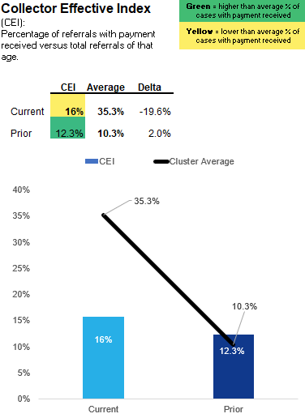
Collector Effective Index (CEI)
Definition: The Collector Effective Index (CEI) shows the percentage of referrals with payment received versus total referrals of that age.
What it Means:
CEI shows an entity’s effectiveness at collecting referrals of a specific age by calculating the percentage of cases with payment for debts of a specific, pre-determined age.
CEI give a numeric (percentage) and visual representation of how an entity is performing versus peers in collecting referrals of a specific age.
Entities should strive to maximize CEI for both Current and Prior referrals.
Notes:
The CEI will show how effective the entities are at collecting on delinquent case referrals of a certain age; that is, new cases established in the Current Period and old cases established in all Prior Periods.
The goal is for each entity to strive to maximize the CEI for both Current and Prior Period case referrals.
Based on available data, the entities are generally more effective at collecting on new cases established in the Current Period, since collectability tends to drop as the debt ages. Alameda was indeed more effective at collecting on Current Period case referrals. However, when compared to the cluster average, they were LESS effective at collecting on Current Period referrals.
You’ll notice the green and yellow highlighted areas; a value highlighted green is a “positive” outcome.
A value highlighted yellow is not bad…it simply means that there is an opportunity… or “room for improvement.”
Missing or no data is also highlighted yellow.

Slide 12
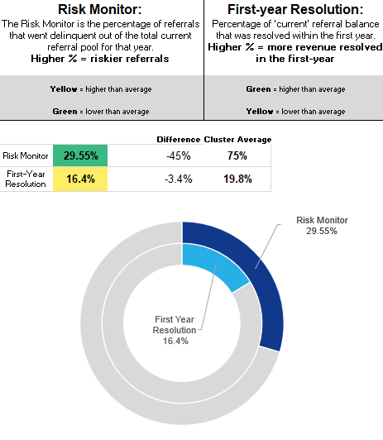
First-Year resolution rate
Definition: First-year Resolution is the percentage of 'current' referral balance that was resolved within the first year.
What it Means:
How effective entities are at collecting and resolving first-year (current) referrals within that year
This shows the percentage of current referral dollars that were resolved within the first year through collections, adjustments and/or discharges. Higher percentages mean an entity was able to resolve more first-year debt.
Entities should strive to make First-year Resolution Rate as high as possible.
First-year Resolution:
Green = Higher (good, more referrals resolved in 1st year)
Yellow = lower (improvement, fewer referrals resolved in 1st year)
Notes:
The first-year resolution rate will show how effective entities are at collecting and resolving referrals within the first year of receiving the case—
For this metric, the goal is for the entities to score as high as possible.
Alameda resolved 16% of “current period” referrals through collections, adjustments, and discharge; the rate is lower than the Cluster average of 20%; meaning that there is room for improvement, as fewer referrals were resolved in the first year.

Slide 13
Spend Efficiency Score
Definition: The Spend Efficiency Score is the number of dollars spent to collect $1 in delinquent referrals for the various programs. ​
What it Means:
SES shows the cost to collect $1 in delinquent referrals.
An SES for Private Agency of 0.2 means that an entity spent 20 cents to collect each dollar of delinquent referrals when using that program.
Low SES means an entity is spending less to collect delinquent referrals, a high SES means an entity is spending more to collect delinquent referrals. An SES greater than 1 should always be investigated.
Notes:
The Spend Efficiency Score (or SES) is one of two metrics that looks at cost effectiveness.
The SES is designed to give the entities a sense of how efficiently they can collect delinquent referrals by showing the amount of money spent to collect one dollar in delinquent referrals.
Alameda uses the collection services of a private agency and the Franchise Tax Board. Overall, the private agency was the most cost effective, they spent 13 cents to collect one dollar of delinquent referrals for the Current Period and 10 cents on referrals from Prior Periods.

Slide 14
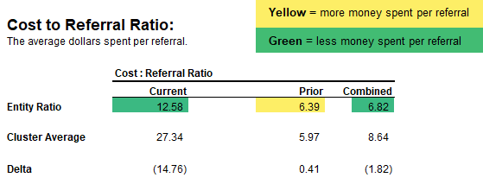
Cost to referral ratio
Definition: Cost to Referral ratio show the average dollars spent (costs) per referral.
What it Means:
The Cost to Referral ratio is helpful when entities are looking to compare relative operating costs with other entities, and to the cost of administering justice.
This benchmark shows the average cost-per-referral for current, prior, and combined referrals, in addition to the cost-per-total cases resolved.
Notes:
The fourth and last performance metric will give the entities a better idea of how much they spend per referral (or case), by specific age, meaning Current and Prior Periods.
Alameda spent $13 per referral established in the current period; that is $15 LESS per referral than the amount spent by others in the same cluster.
That is the last performance metric, can I answer any questions?
Don will now review the normalizing metrics and the dashboard.

Slide 15
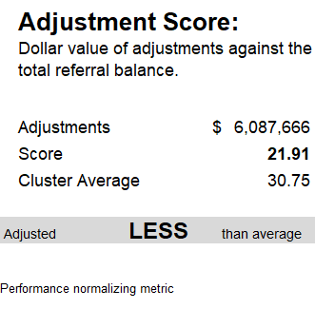
Adjustment score
Definition: Adjustment Score is a representation of the dollar value of adjustments against the total referral balance.
What it Means:
The relative amount of revenue that an entity adjusted through non-cash means.
The adjustment score is a normalizing metric and is intended to help entities understand where they stand in terms of adjustments with the other entities in their cluster.
Notes:
Adjustment Score is a representation of the dollar value of adjustments made by the program against the total balance of court-ordered debt.
The score is a representative number (it is not a percentage) and should be used as a reference to help understand the relative impact of adjustments from entity to entity.
Alameda’s score for this measure is lower than other members of its cluster, indicating relatively fewer adjustments of outstanding referrals.

Slide 16
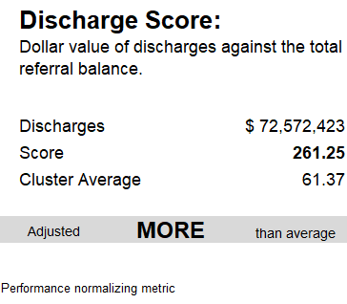
Discharge score
Definition: Discharge Score is a representation of the dollar value of discharges against the total referral balance.
What it Means:
The relative amount of revenue that an entity discharged.
The discharge score is a normalizing metric and is intended to help entities understand where they stand in terms of discharges with the other entities in their cluster.
Notes:
Adjustment Score is a representation of the dollar value of discharges made by the program against the total balance of court-ordered debt.
The score is a representative number (it is not a percentage) and should be used as a reference to indicate to what extent an entity makes use of discharge relative to its peers with the cluster group.
As we see in this slide, Alameda has a discharge score significantly higher than the cluster average.

Slide 17
Risk monitor
Definition: The Risk Monitor is the percentage of referrals that went delinquent out of the total current referral pool for that year.
What it Means:
The Risk Monitor is designed to assign a ‘riskiness score’ to an entity’s current year referrals to help the entity (and JCC) set expectations for performance on those specific referrals.
A high-Risk Monitor means fewer referrals were paid before going delinquent and the remaining pool is riskier
A low-Risk Monitor means more referrals were paid before going delinquent and the remaining pool is less risky
Notes:
The Risk Monitor shows the number of cases which became delinquent as a share of the total current or first-year referrals, including non-delinquent cases.
This will give collection entities a better gauge of how often accounts are referred to collections, and ultimately how challenging it may prove to resolve cases.
As we can see here, Alameda has a much lower score than other entities in its cluster, indicating fewer cases becoming delinquent and a lower risk of non-performing accounts.

Slide 18
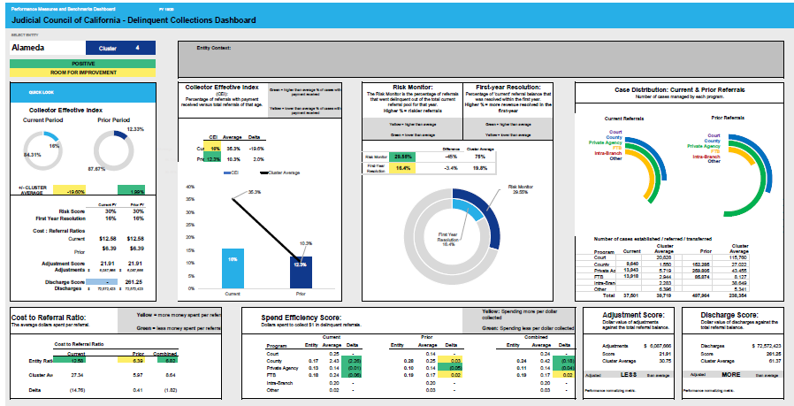
Dashboard
Notes:
This is a sample dashboard–Attachment B
The dashboard is designed to provide entities both a descriptive and visual representation of each metric. There is a lot to take in on the dashboard, and this may not be the final visual as we are open to input and continue to look for ways to improve.
Rather than assign specific benchmark percentages to each metric, Forrester included the ‘cluster average’ (found in Attachment C) on the dashboard so entities can measure how they stack up versus their peers, collection programs of a similar size. Because the cluster averages change year-over-year, Forrester believes that averages will serve as a better and more useful ‘benchmark’ for the entities and will foster greater collaboration with their peers.
Early feedback from collection entities indicates that the increased detail of the proposed performance measures will be more useful than the two currently in use

Slide 19
Questions/Discussion

