Slide 1
Revenue Distribution Training March 2013
Presented by the
State Controller’s Office
and the
Administrative Office of the Courts
Notes:
Notes:
Self-introduction by opening presenter (keep it short, name and title only)
Introduce AOC and/or SCO Executive Sponsors for opening remarks.

Slide 2
INTRODUCTION
Notes:
Consider removing this slide as not really necessary since opening remarks speakers can be introduced at first slide.
Consider moving housekeeping slide here instead.

Slide 3
Faculty and Contacts
State Controller’s Office:
Jim Reisinger
Darryl Mar
Sandeep Singh
Administrative Office of the Courts:
John Judnick
Robert Cabral
Ryan Mendoza
jreisinger@sco.ca.gov
dmar@sco.ca.gov
sxsingh@sco.ca.gov
john.judnick@jud.ca.gov
robert.cabral@jud.ca.gov
ryan.mendoza@jud.ca.gov
Notes:
Consider moving up faculty slide to after agenda.

Slide 4
Housekeeping Information
Breaks: 15 minutes
Lunch: 60 minutes, lunch will be provided.
Restrooms: Hallway, same floor
Questions:
Please ask at any time and use the microphone.
Please use index cards to submit written questions, and include your name in case we need more information.
Evaluations: Please complete and return after each break.
Notes:
Notes:
Please include your name and organization when submitting written questions in case we need more information from you. Be explicit with your questions when writing them down. Use index cards and they will be picked up frequently.

Slide 5
Training Agenda
9:30 – Opening and Introduction
Complexity of Revenue Collection and Distribution Process
Court Ordered Debt Task Force
9:45 – Distribution Resources
Judicial Council - Uniform Bail and Penalty Schedule
State Controller’s Office - Appendix C
11:00 – Morning Break
11:15 – Revenue Distribution Audits
11:45 – Statutes
12:30 – Lunch Break
Times are approximate.
Notes:
Consider removing details from slide and placing details in notes.
Notes:
Opening and Introduction:
Housekeeping
Training expectations and goals
Faculty and contacts
Court Ordered Debt Task Force
Distribution Resources
Judicial Council - Uniform Bail and Penalty Schedule
State Controller’s Office - Appendix C

Slide 6
Training Agenda
1:30 – Breakout Sessions – A
Parking
Basic Distributions
2:45 – Afternoon Break
3:00 – Breakout Sessions – B
Special Distributions
Hands On Specific Issues
4:15– Closing
Evaluations
Questions and answers
WebEx training
4:30 - End
Times are approximate.
Notes:
Same note as prior slide.

Slide 7
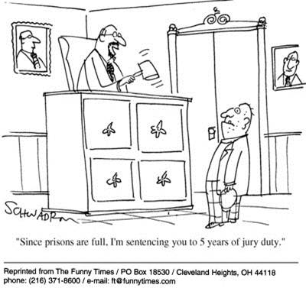

Slide 8
Attendee Expectations
Notes:
Survey responses.
What do you want to get out of this instruction?

Slide 9
Instruction Goals
Identify sources of resource materials for distribution calculation, analysis, and research.
Walk-through and explain calculations of distribution examples for select case types using worksheet tools.

Slide 11
Court-Ordered Debt
Task Force

Slide 12
Court-Ordered Debt Task Force (CODTF)
Established by Penal Code 1463.02(b)
Representatives from various
State entities, agencies, and organizations
Counties, cities, and other external organizations

Slide 13
CODTF PRIMARY GOALS (PC 1463.02(b))
Identify all criminal and traffic-related court-ordered fees, fines, forfeitures, penalties and assessments imposed under law.
Identify the distribution of revenue derived from those debts and the expenditures made by those entities that benefit from the revenues.
Consult with state and local entities that would be affected by a simplification and consolidation of criminal and traffic-related court-ordered debts.
Evaluate and make recommendations to the Judicial Council and the Legislature for consolidating and simplifying the imposition of criminal and traffic-related court-ordered debts and the distribution of the revenue derived from those debts with the goal of improving the process for those entities that benefit from the revenues, and recommendations, if any, for adjustment to the court-ordered debts.

Slide 14
CODTF ACTIVITIES
Current activities of CODTF subgroups:
Survey to determine revenue streams to state, counties, cities, etc., and associated financial information
Evaluation of SCO Appendix C
Sponsor training on revenue distribution

Slide 15
RESOURCES

Slide 16
Distribution Resource Interrelationships
Statutes
SCO Revenue Distribution Guidelines, Appendix C
Judicial Council Uniform Bail and Penalty Schedule
Revenue Distribution Audit Worksheets

Slide 17
Distribution Resource Sites
California Statutes: leginfo.legislature.ca.gov/faces/codes.xhtml
Distribution Resources/Guides:
JC Uniform Bail and Penalty Schedules www.courts.ca.gov/documents/2013-JC-BAIL.pdf
Email Distribution Questions to AOC DistributionQuestions@jud.ca.gov
SCO Appendix C Guidelines www.sco.ca.gov/ard_trialcourt_manual_guidelines.html
Distribution Training Materials www.sco.ca.gov/ard_trialcourt_manual_guidelines.html
Local Court Websites: www.courts.ca.gov/find-my-court.htm
County Websites: www.csac.counties.org/county-websites-profile-information
Audit Reports:
State Controller’s www.sco.ca.gov/aud_court_revenues.html
AOC www.courts.ca.gov/12050.htm
Notes:
FYI - Moved up California statutes.

Slide 18
JUDICIAL COUNCIL

Slide 19
Judicial Council Uniform Bail and Penalty Schedules (Rule 4.102)
PC 1269b(c): requires that courts prepare, adopt, and annually revise a uniform countywide schedule of bail for all bailable felony offenses and for all misdemeanor and infraction offenses except Vehicle Code infractions.
The penalty schedule for infraction violations of the Vehicle Code shall be established by the Judicial Council in accordance with Section 40310 of the Vehicle Code.
VC 40310: requires Judicial Council to annually adopt a uniform traffic penalty schedule for all non-parking Vehicle Code infractions.

Slide 20
Countywide Schedule of Bail
The judges in each county adopt a countywide bail schedule that sets bail based on the requirements that apply to that jurisdiction.
Each countywide bail schedule may have bail amounts that are different from the council's bail amounts.
You must contact the court where a case is filed to get local bail information for that court.

Slide 21
JC Uniform Bail and Penalty Schedules www.courts.ca.gov/documents/2013-JC-BAIL.pdf
The Uniform Bail and Penalty Schedules are revised to conform to recent legislation. The Judicial Council adopted the proposed 2013 Uniform Bail and Penalty Schedules at the December 2012 council meeting.

Slide 22
JC Uniform Bail and Penalty Schedules
Purpose of schedules:
To provide the standard bail amount, which for Vehicle Code offenses is the amount that may be used for a bail forfeiture instead of further proceedings.
Serve as a guideline for the imposition of a fine as all or a portion of the penalty for a first conviction of a listed offense where a fine is used as all or a portion of the penalty for such offense.

Slide 24
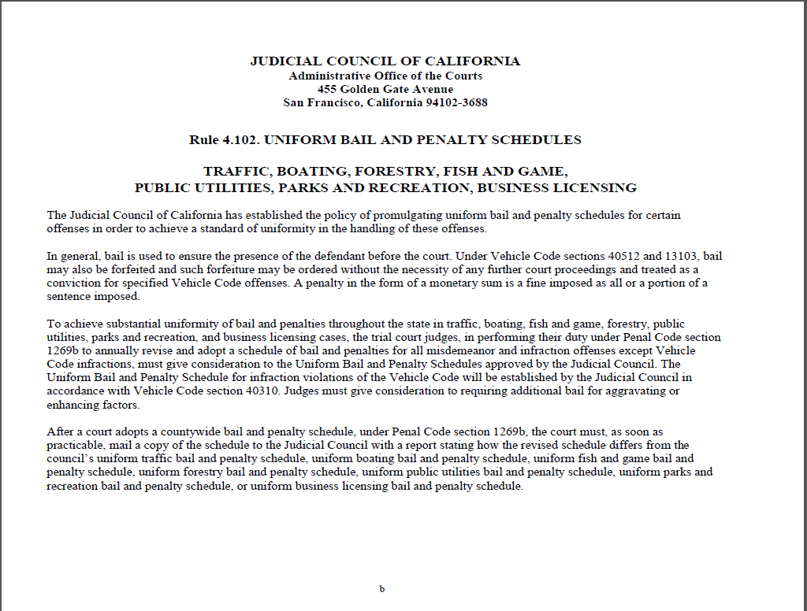

Slide 25
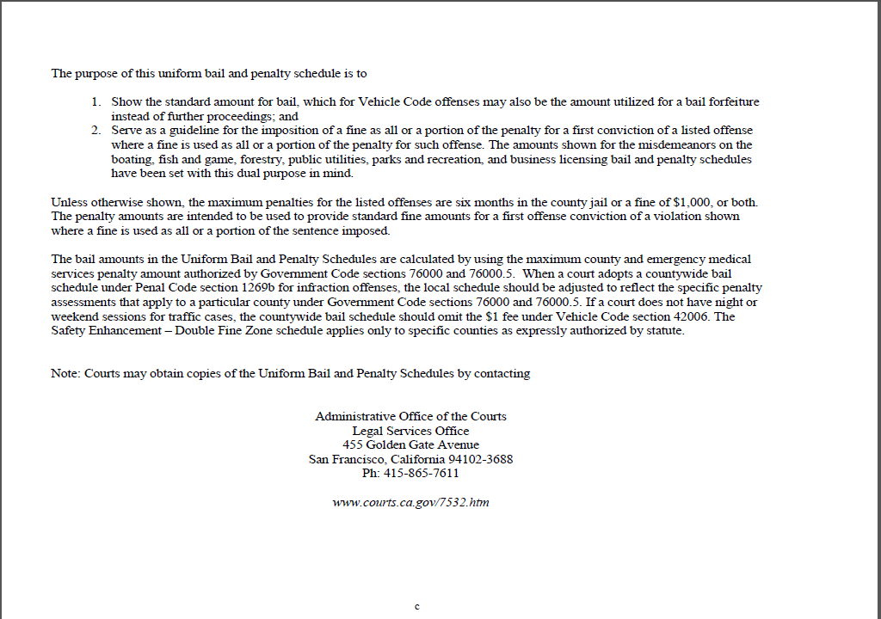

Slide 26
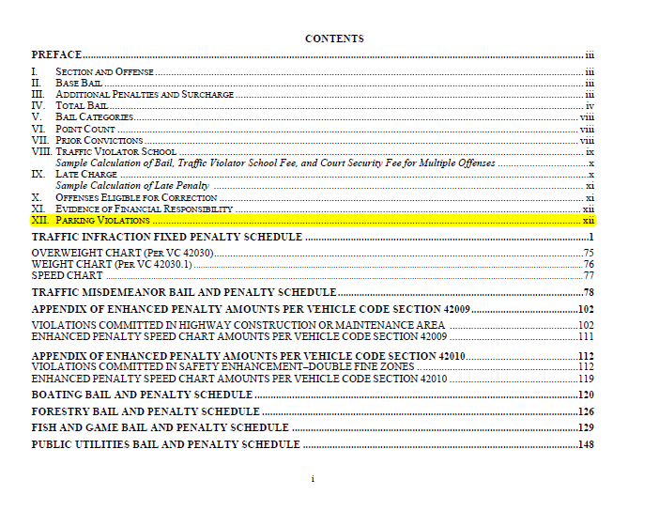

Slide 27
Questions?

Slide 28
Placeholder for State Controller’s Office Slides

Slide 29
Morning Break
(15 Minutes, please)

Slide 30
AOC Internal Audit Services Audits
www.courts.ca.gov/12050.htm
Notes:
IAS audit objective different than SCO audit objective.
IAS = Identifying current period distribution issues to correct prospectively.
SCO = Identifying prior years’ distribution issues to correct/adjust distributions. Penalties may result if State monies under-remitted.

Slide 31
Audit Comments
Minimize Under-Remittance Penalties
Penalties for Under-Remittance to the State
Destruction of Records Between Audits (FIN Manual - Record Retention, Policy FIN 12.01, 6.1)
Records: Receipts for Fines, Fees, Penalties Collected and other collection receipts
Retention: Current year plus four additional years (or from the close date of the State Controller’s Office audit, whichever is longer)
Suggestion: Confirm with SCO before destroying records
Notes:
Notes:
SCO penalties may be large if distribution error causes large under-remittance to State.
Entities can be proactive and identify distribution issues by reviewing revenue distribution issues from published audit reports.
FIN Manual, Policy FIN 12.01, provides guidance on destruction of financial records. Generally, current year plus 4 years. However, must keep until SCO completes revenue audit. Request SCO approval to destroy financial records after completion of revenue audit.

Slide 32
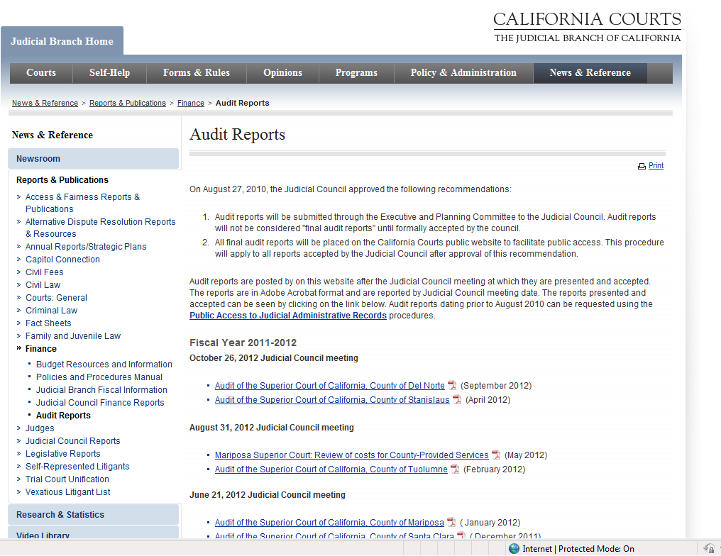

Slide 33
Audit Report Issues
Some of the more common Revenue Distribution issues reported:
2% State Court Automation is not calculated from all applicable fines and penalties.
30% Red Light/Railroad Allocations are not from correct fines and penalties (exclude DNA and EMS, except traffic school).
Red Light, Railroad, Child Seat traffic school distributions do not follow applicable statutes.
Notes:
Notes:
2% = For example, some courts did not distribute 2% from new $4 EMAT penalty.
30% = For example, 30% allocation does not apply to GC 76104.6 and 76104.7 DNA and GC 76000.5 EMS penalties.
RLTS/RRTS = Some distribute using PC rather than VC TS codes. CSTS = some distribute using TS 42007 distribution but TS distribution not applicable to CS.

Slide 34
California Statutes

Slide 35
New Statutory Changes
Governor signs legislation that will effect distributions. Some keys to be aware of:
Chapter date
Effective date
Urgency legislation
Example:
AB 2094, effective 01/01/13, increases the domestic violence fee from a minimum of $400 to a minimum of $500, and requires the court to state a reason on the record if it reduces or waives the minimum fee.

Slide 36
BASIC RULES
7 of 10 “or portion thereof” concept (round-up)
“Not withstanding any other provision of law”
Discretionary language – May, Should
Mandatory language – Shall, Must, Will

Slide 37
BASIC RULES
Base fine and enhancement
Waivers, community service, jail time
Arresting Agencies (City, Sheriff, CHP)
Local ordinances (i.e., GC 76000 local penalties)
Timely update of master distribution tables – plan ahead and prepare for changes
Notes:
Fee waivers – completion of form. Mix of community service/jail time with an assessment – how to value

Slide 38
BASIC RULES
If new statutory sections impose fines, which are punitive, the increased amounts may only be imposed on convictions for violations that occurred on the date of the increase (which for many new statutes is January 1, 2013) or afterwards.
Imposing the increased fines on violations that occurred prior to the date of the increase would violate ex post facto prohibitions.
Notes:
Fees do not apply above. Fees can be retrospective but usually are not.

Slide 39
BASIC RULES
Top Down vs. Bottom Up Assessments
PC 1463.004: If a sentencing judge specifies only the total fine or forfeiture, or if an automated case-processing system requires it:
Percentage calculations may be employed to establish the components of total fines or forfeitures
Provided that the aggregate monthly distributions resulting from the calculations are the same as would be produced by strict observance of the statutory distributions.
Notes:
Many ways to do this and we see inconsistency. In breakout session we will provide example of one approach.
Judicial discretion - Assessment of less than the mandatory statutory requirements and what then gets covered on collecions and then distribution

Slide 40
VC 40508.6
Example of reading statute:
40508.6. The superior court in any county may establish administrative assessments, not to exceed ten dollars ($10), for clerical and administrative costs incurred for the following activities:
(a)An assessment for the cost of recording and maintaining a record of the defendant's prior convictions for violations of this code. The assessment shall be payable at the time of payment of a fine or when bail is forfeited for any subsequent violations of this code other than parking, pedestrian, or bicycle violations.
(b)An assessment for all defendants whose driver's license or automobile registration is attached or restricted pursuant to Section 40509 or 40509.5, to cover the cost of notifying the Department of Motor Vehicles of the attachment or restriction.

Slide 41
Discussion of Specific Statutes
State Penalty – PC 1464
Local Penalties – GC 76000(a)
Additional State and Local Penalties
Installment Payment Fee – PC 1205
20% State Surcharge – PC 1465.7
2% State Court Automation – GC 68090.8
Priority of Installment Payments – PC 1203.1d
Maintenance of Effort (MOE) Payments
Traffic Violator School Fee (TVS) – VC 42007
Notes:
Need to fix. Slides that follow do not track with contents of this slide.

Slide 42
State Penalty – PC 1464
There shall be levied a state penalty in an amount equal to $10 for every $10 or fraction thereof, upon every fine, forfeiture or penalty imposed on criminal offenses with some exceptions listed at PC 1464(a) (1).
After a determination by the court of the amount due, the clerk of the court shall collect the penalty and transmit it to the county treasury.
Seventy percent (70%) of the remaining balance shall be transmitted to the state treasury for deposit in the State Penalty Fund
Thirty percent (30%) remaining to stay on deposit in the county general fund.
The State Penalty Fund is further distributed to various state funds in percentages specified in PC 1464 (f).

Slide 43
State Penalty – PC 1464
1464.
(a) (1) Subject to Chapter 12 (commencing with Section 76000)
of Title 8 of the Government Code, and except as otherwise provided
in this section, there shall be levied a state penalty in the amount
of ten dollars ($10) for every ten dollars ($10), or part of ten
dollars ($10), upon every fine, penalty, or forfeiture imposed and
collected by the courts for all criminal offenses, including all
offenses, except parking offenses as defined in subdivision (i) of
Section 1463, involving a violation of a section of the Vehicle Code
or any local ordinance adopted pursuant to the Vehicle Code.

Slide 44
State Penalty – PC 1464
(3) The penalty imposed by this section does not apply to the
following:
(A) Any restitution fine.
(B) Any penalty authorized by Chapter 12 (commencing with Section
76000) of Title 8 of the Government Code.
(C) Any parking offense subject to Article 3 (commencing with
Section 40200) of Chapter 1 of Division 17 of the Vehicle Code.
(D) The state surcharge authorized by Section 1465.7.
(b) Where multiple offenses are involved, the state penalty shall
be based upon the total fine or bail for each case. When a fine is
suspended, in whole or in part, the state penalty shall be reduced in
proportion to the suspension.

Slide 45
Local Penalties GC 76000 (a)
76000. (a) (1) Except as otherwise provided elsewhere in this section, in each county there shall be levied an additional penalty in the amount of seven dollars ($7) for every ten dollars ($10), or part of ten dollars ($10), upon every fine, penalty, or forfeiture imposed and collected by the courts for all criminal offenses, including all offenses involving a violation of the Vehicle Code or any local ordinance adopted pursuant to the Vehicle Code.

Slide 46
Local Penalties GC 76000 (a)
76000. (a) (2)
This additional penalty shall be collected together with and in the same manner as the amounts established by Section 1464 of the Penal Code.
These moneys shall be taken from fines and forfeitures deposited with the county treasurer prior to any division pursuant to Section 1463 of the Penal Code.
The county treasurer shall deposit those amounts specified by the board of supervisors by resolution in one or more of the funds established pursuant to this chapter.
However, deposits to these funds shall continue through whatever period of time is necessary to repay any borrowings made by the county on or before January 1, 1991, to pay for construction provided for in this chapter.

Slide 47
Local Penalties GC 76000 (a)
(a) (3) This additional penalty does not apply to the following:
(A) Any restitution fine.
(B) Any penalty authorized by Section 1464 of the Penal Code or this chapter.
(C) Any parking offense subject to Article 3 (commencing with Section 40200) of Chapter 1 of Division 17 of the Vehicle Code.
(D) The state surcharge authorized by Section 1465.7 of the Penal Code.

Slide 48
Local Penalties GC 76000 (a)
76100 Local Courthouse Construction Fund (BOS)
76101 Criminal Justice Facilities Construction Fund (BOS)
76102 Automated Fingerprint/Digital Image Identification Fund (BOS)
76104 Emergency Medical Services Fund (BOS)
76104.5 DNA Identification Fund (BOS)

Slide 49
Additional Penalties
Additional State and Local Penalties:
76000.5 Emergency Medical Services Additional Penalty (BOS: 2/10)
76000.10(c) Emergency Medical Air Transportation Penalty ($4 per VC conviction)
76104.6 DNA Additional Penalty (1/10; 75% County/25% State split)
76104.7 DNA Additional State-Only Penalty (4/10)
70372 State Court Construction Penalty (5/10)
Immediate and Critical Needs Account (same $ as LCCF)
State Court Facilities Construction Fund (remainder of 5/10)

Slide 50
Installment Payment Fee
Penal Code Section 1205
(e) The defendant shall pay to the clerk of the court or the collecting agency a fee for the processing of installment accounts. This fee shall equal the administrative and clerical costs, as determined by the board of supervisors, or by the court, depending on which entity administers the account.
The defendant shall pay to the clerk of the court or the collecting agency the fee established for the processing of the accounts receivable that are not to be paid in installments.
The fee shall equal the administrative and clerical costs, as determined by the board of supervisors, or by the court, depending on which entity administers the account, except that the fee shall not exceed thirty ($30) dollars.

Slide 51
Installment Payment Fee
Penal Code Section 1205
(d) Nothing in this section shall be construed to prohibit the clerk of the court, or the judge if there is no clerk, from turning these accounts over to another county department or a collecting agency for processing and collection.
(f) This section shall not apply to restitution fines and restitution orders.

Slide 52
Insert SCO Slides Here

Slide 53
Lunch Break
(60 minutes, please)

Slide 54
Breakout Sessions
Parking
Basic Distribution Calculations

Slide 55
Afternoon Break
(15 minutes, please)

Slide 56
Breakout Sessions
Special Distribution Calculations
Hands-on Court/County – Specific Issues

Slide 57
Closing

Slide 58
CLOSING
Review instruction goals and expectations
Identify sources of revenue distribution resources
Walk-through distribution examples
Questions and answers – FAQ’s
Evaluations
Next session
Webinar

Slide 59
Instruction Goals and Expectations
Covered the Following:
Identify sources of resource materials for distribution calculation, analysis, and research.
Walk-through and explain calculations of distribution examples for select case types using worksheet tools.
Expectations:
Identified expectations from survey/discussion

Slide 60
Questions and Answers
All questions submitted to be discussed.
Responses to be discussed between SCO and AOC
Frequently Asked Questions

Slide 61
Other Items
Evaluations
Webinar
Next Session

Slide 62
THE END
THANK YOU

