Slide 1
Workers’ Rights Clinic Collaborative
Ana de Alba, Lang Richert & Patch
Paul Carter Mullen, Central CA Legal Services Inc.
Vicente Sanchez Ventura, Consulate of Mexico in Fresno

Slide 2
Who are we?
Ana de Alba—Shareholder at Lang, Richert & Patch and Board Member of Legal Aid Society – Employment Law Center
Paul Mullen – Voluntary Legal Services Program Director at Central California Legal Services
Consul Vicente Sanchez Ventura, Head Consul of México in Fresno

Slide 3
What is the Workers’ Rights Clinic?
The WRC in Fresno is a first of its kind collaborative effort between Legal Aid Society – Employment Law Center (“LAS-ELC”), Central California Legal Services, Inc. (“CCLS”), Consulate of Mexico in Fresno, and Lang, Richert & Patch.
The WRC in Fresno is one of the many LAS-ELC clinics in the state.

Slide 4
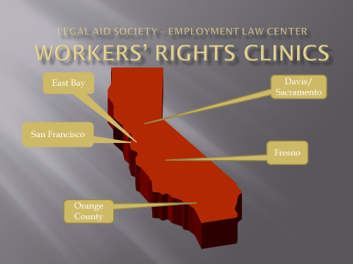
Workers’ Rights Clinic Collaborative

Slide 5
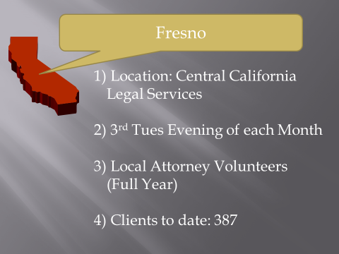
Workers’ Rights Clinic Collaborative

Slide 6
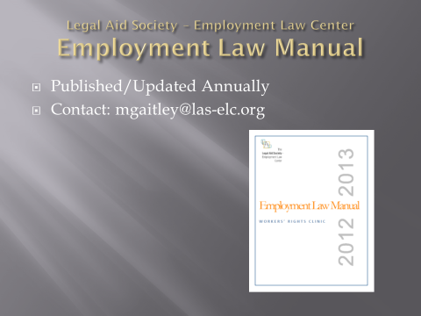
Workers’ Rights Clinic Collaborative

Slide 7
Role of the Private Bar
Unlike most LAS-ELC clinics, the WRC in Fresno is staffed primarily by local attorneys, not law students.
Most of our attorney volunteers neither speak Spanish nor primarily practice in the area of employment law.
There are two supervising attorneys, Michael Gaitley and Charles Trudrung Taylor, who have over 40 years combined experience in employment law.

Slide 8

Voluntary Legal Services Program

Slide 9
Central CA Legal Services Inc.
Voluntary Legal Services Program
CCLS is a LSC funded non-profit law firm that provides free civil legal services to qualified low-income individuals, primarily in the counties of Fresno, Kings, Mariposa, Merced, Tulare and Tuolumne.
Our clients are the working poor, families with young children, the disabled, veterans, victims of domestic violence, elder abuse, and other low-income individuals.

Slide 10
Central CA Legal Services Inc.
Voluntary Legal Services Program
The Voluntary Legal Services Program (VLSP), a project of Central California Legal Services, Inc., is the primary vehicle for pro bono assistance to low-income individuals in Central California.
VLSP recruits and supports pro bono attorneys, law students, and other volunteers who assist low-income clients in civil legal matters without charging a fee.

Slide 11
The Workers’ Rights Clinic
Workers’ Rights Clinic in Fresno is a free monthly legal clinic.
Held on the 3rd Tuesday each month.
3 Locations: Fresno CCLS main office
  Merced & Visalia via Google Hangouts (video).
“Legal Information” about workers’ rights and employment law is provided to workers by trained volunteer attorneys and law students.

Slide 12
The Workers’ Rights Clinic
“Legal Information” means substantive legal information not tailored to an individual client.
Providing legal information does not require eligibility screening but must conform to the recipient’s program priorities. 45 C.F.R. § 1614.3(f).
NO legal advice is given at the WRC in Fresno.

Slide 13
WRC: The Role of CCLS/VLSP
Provide Physical Location:
  Fresno Main CCLS Office
  Merced and Visalia (via Google Hangouts)
Registration of Workers:
  toll free number
  Google spreadsheet

Slide 14
WRC: The Role of CCLS/VLSP
Confirm attendance by volunteers:
  Track volunteer participation and hours.
Copy and distribute WRC materials:
  LAS-ELC intake forms.
  WRC folders (English & Spanish).

Slide 15
WRC: The Role of CCLS/VLSP
WRC logistics: matching workers + volunteers.
Coordinate video interviews and interpreters.
Facilitate training for new volunteers (MCLE).
Note: LAS-ELC supervises the delivery and quality of legal information provided by volunteers.

Slide 16
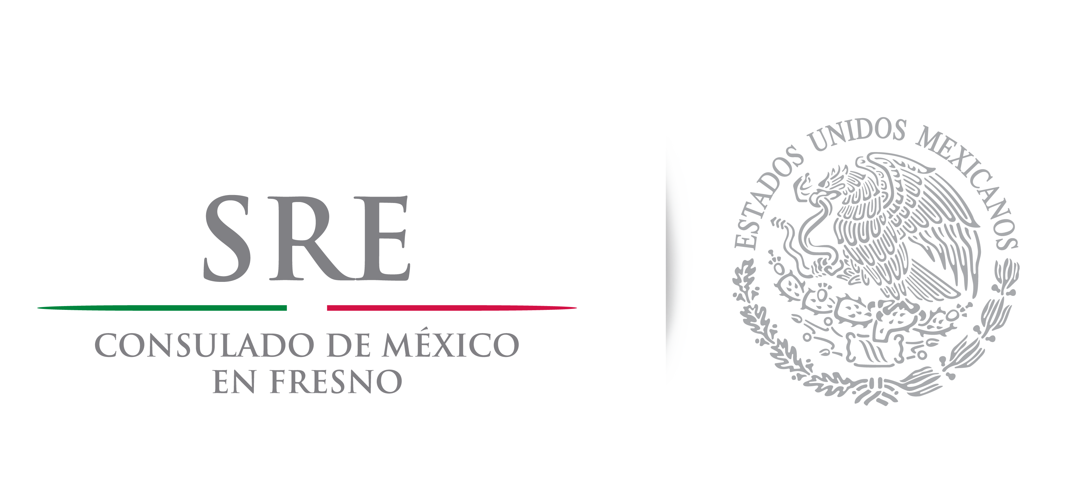
Consulate of Mexico in Fresno

Slide 17
Consulate of Mexico in Fresno
The Consulate of Mexico in Fresno was established in the 1930’s and is the only Diplomatic Representation in the Central Valley, serving 1.5 million Mexican Nationals.
Our jurisdiction includes the Counties of Fresno, Mariposa, Inyo, Merced, Madera, Kings, Tulare and Kern.

Slide 18
Consulate of Mexico in Fresno
Mexico has one of the largest Consular Networks in the world. In the U.S. alone, there are 50 Consulates; 10 in California (Calexico, Fresno, Los Angeles, Oxnard, Sacramento, San Bernardino, San Diego, San Francisco, San Jose, Santa Ana).

Slide 19
Consulate of Mexico in Fresno
The Consulate of Mexico in Fresno operates under the Vienna Convention on Consular Relations (1963) and the Consular Convention between the United States of America and the United Mexican States (1942).
Our duties are exercised at all times in conformity with the domestic laws and regulations.

Slide 20
Consulate of Mexico in Fresno
One of the Consular functions consists in protecting and assisting our nationals, and safeguarding their interests within the limits permitted by international law.

Slide 21
Characteristics of the Mexican Community in the Central Valley
There is a large population coming from indigenous communities who do not necessarily speak Spanish, let alone English.
Many of them work in the fields and have low education levels. A large portion lack proper documentation.
The fear of deportation is always present because it would lead to separation from their families.

Slide 22
Characteristics of the Mexican Community in the Central Valley
Our community is often not fully aware of their rights, they might even be afraid to approach the authorities to denounce a crime.
Most of them are unfamiliar with the community resources available to solve their problems.

Slide 23
How the Consulate of Mexico in Fresno Collaborates with the WRC
The Department of Protection and Legal Affairs at the Consulate permanently attends the WRC and
  Provides interpretation services
  Assists workers with the WRC intake forms
  Answers general questions.

Slide 24
How the Consulate of Mexico in Fresno Collaborates with the WRC
Publicizing the event in our radio shows and television appearances, social media, offices, and our expansive contacts list.
The Consulate’s presence at the Clinic, gives our Nationals a sense of trust and understanding.

Slide 25
How the Consulate of Mexico in Fresno Collaborates with the WRC
Every August, the Consulate organizes a Labor Rights Week (Semana de Derechos Laborales) in which we host several organizations, including the US Department of Labor.
On that month, the Workers’ Rights Clinic is held at the Consulate and is usually the Clinic with the biggest turnout.

Slide 26
How the Consulate of Mexico in Fresno Collaborates with the WRC
The Consulate of Mexico in Fresno appreciates the hard work of our partnering organizations in this effort and affirms its commitment to keep working side by side with them to ensure even more Mexican Nationals take advantage of the Clinic and make their rights count.

