Slide 1
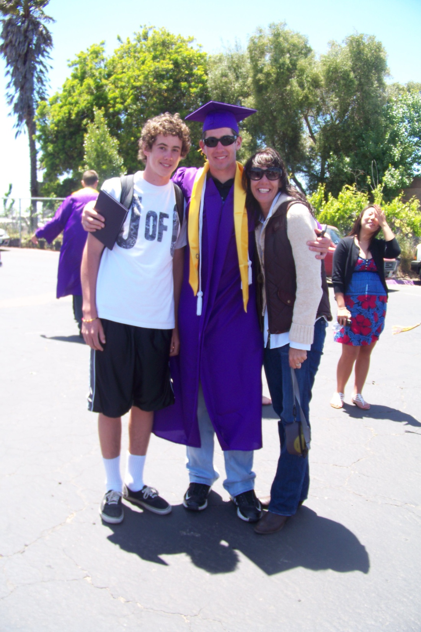
Defining Civic Duty and Participation

Slide 2
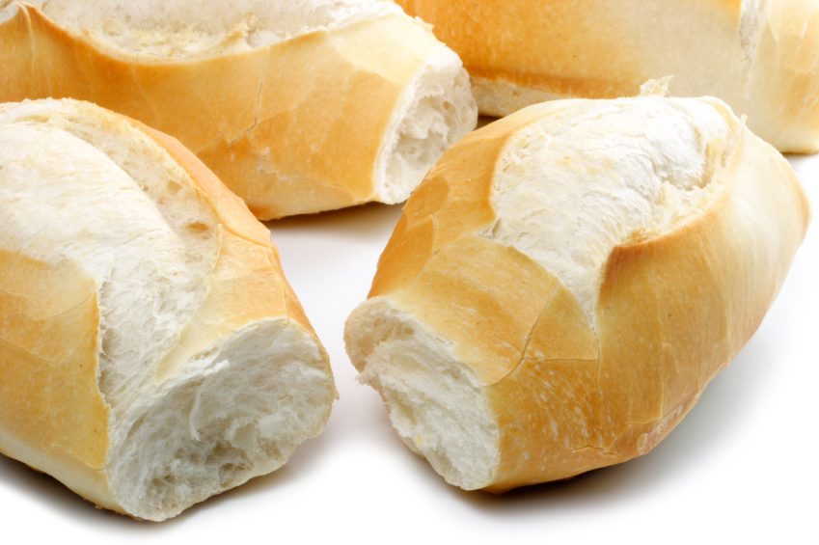
ABSOLUTELY NECESSARY:
Butter
Flour, all-purpose or bread
Salt
Shortening, spray or solid
Sugar
Water
Yeast, active dry or rapid rise

Slide 3

Agree
Strongly Agree
Disagree
Strongly Disagree

Slide 4
Everyone should have to pick up one bag of litter per day to keep our community looking nice.

Slide 5
All K – 12th grade students should have to participate in Boy Scouts, Girl Scouts or some other after school organization.

Slide 6
Upon turning 18 years of age, one must serve a minimum of 2 years in some area of the armed forces.

Slide 7
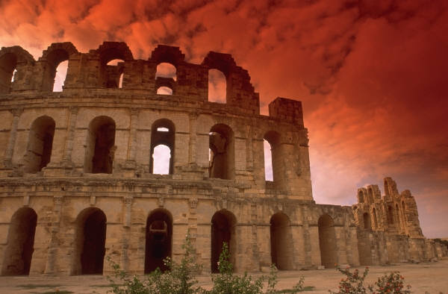
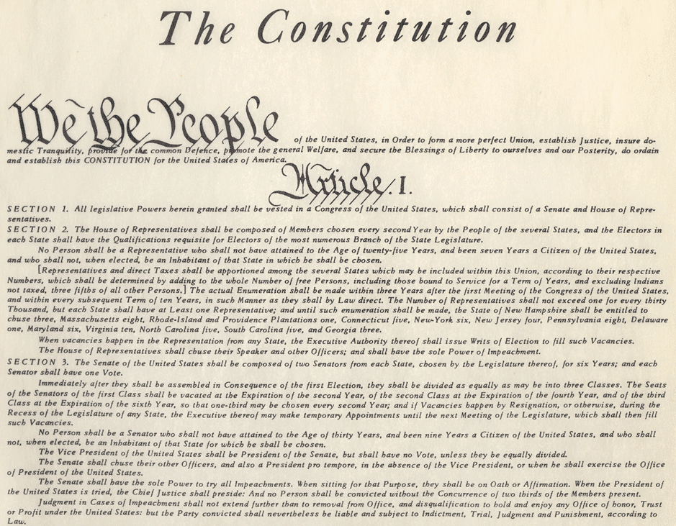
Roman Republic Resource
Key Features:
Written Constitution

Slide 8
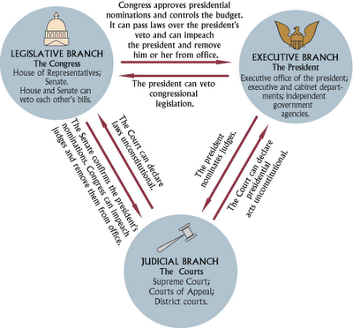
Key Features:
Tripartite Government

Slide 9
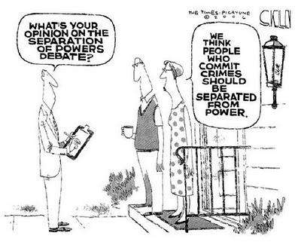
Key Features:
Checks and Balances

Slide 10
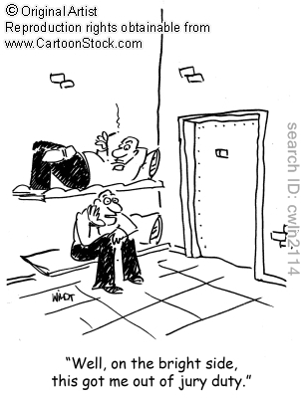
Key Features:
Civic Duty

Slide 11
Elements of ART
Line, Shape, Space, Form, Texture, Color, Value

Slide 12
Line
Straight lines reflect: strength, artificial or manmade structures, directness.
Curved lines reflect: nature, organic structures, indirectness.
Diagonal lines: action
Vertical lines: strength
Horizontal lines: calm

Slide 13
Shape
Organic
Geometric
Closed
Open

Slide 14
Value
Lightest to Darkest of a single hue or color

Slide 15




Texture
Actual: can feel the difference of the surface
Implied: suggested texture

Slide 16
Color Wheel
Triad

Slide 17
Color
Hue: a pure color on the color wheel, could be primary, secondary or tertiary
Tint: any pure color + white
Shade: any pure color + black
Intensity: the bright or dullness of a color
Lower intensity by adding a color complement (opposite color on the wheel)

Slide 18
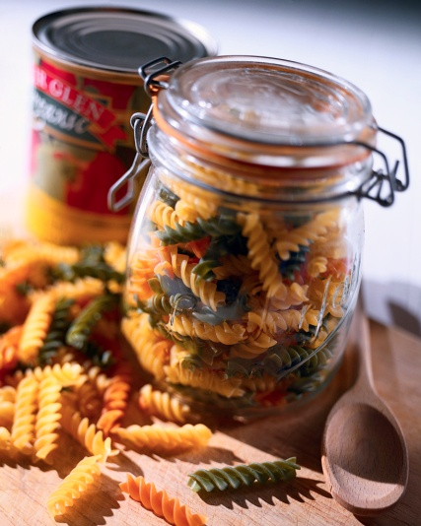
Form and Space (3D)
The container of “positive space” (or that space we recognize as making up an object)
Glass jar is the form.
Positive space is inside the form, negative space is around it.

Slide 19

Illustration
What does civic duty and participation look like to you?

Slide 20

What kind of world do you want?

Slide 21
Are you the key?

