Slide 1
JCC Security Architecture
Cloud Reference Design

Slide 2
Layered Security Approach
Security mechanisms and controls applied at different layers of the application stack to protect confidential/sensitive data stored on servers and storage devices. The common principles used to define security posture are confidentiality, integrity, and availability.
Security Monitoring
Policy and Access Layer
Perimeter
Data
Network
Compute
Application
Monitoring and Logging:
Security event monitoring and alerting
Log management and analysis
External security intelligence (Threat Watch)
Policy & Access
Ensure identities are secure, access is controlled, and changes are logged.
Control access to infrastructure services
Change control
Audit compliance, events, and changes.
Perimeter
Protect assets against network-based attacks by identifying attacks, eliminating impact, and alerting on them.
Use distributed denial-of-service DDOS protection
Use perimeter firewalls.
Network:
Limit network connectivity across all resources and only allow what is required.
Use network segmentation using network level controls.
Deny by default
Restrict inbound internet access and limit outbound
Implement secure connectivity to CCTC data centers
Compute
Install malware protection tools, and latest security patches.
Fine-grained access control.
Server hardening and configuration control.
Application
Work with applications to ensure application is configured according to security best practices, and understand possible vulnerabilities.
Control application access to other resources.
User authentication integration with AD/LDAP
Enable data encryption at rest and in transit at the application layer.
Data:
Follow JCC Enterprise Information Security Principles, and security best practices to protect the data through user authentication/authorization, and network segregation.
Enable Data encryption at rest.
Notes:
The security categorization standard is based on a simple and well-established concept—that is, determining the potential adverse impact for organizational information systems. The results of security categorization help guide and inform the selection of appropriate security requirements (i.e., safeguards and countermeasures) to adequately protect those information systems.

Slide 3
Shared Security Responsibility Model
Cloud Service Providers are responsible for providing secure infrastructure up to the hypervisor level, while customers for securing the operating systems, application platforms, and data. The following AWS diagram is used as a reference.

Slide 4
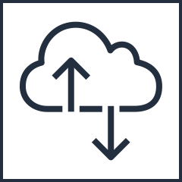
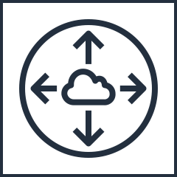
Enterprise Design – Conceptual Design
Cloud Region
Availability Zone a
Availability Zone b
Availability Zone c
VDSS VPC
AZ (a)
AZ (b)
AZ (c)
Production VPC/VNet
Network Firewall Services
Application A
WAF Services
Production VPC/Vnet
Other Security Services
Application B
Internet
Stage—VPC/VNet
Application A
VGW
Stage—VPC/VNet
Peering
Application B
VPN Gateway
VGW
Internet
VDMS VPC
Development-VPC/VNet
AZ (a)
AZ (b)
AZ (c)
Application A
Vulnerability services
AD/DNS/SSO services
Development-VPC/VNet
CCTC
Bastion Service
Application B
Other services
Future Services
Notes:
Virtual Data Center Management Stack (VDMS)
Virtual Data Center Security Stack (VDSS)

Slide 5
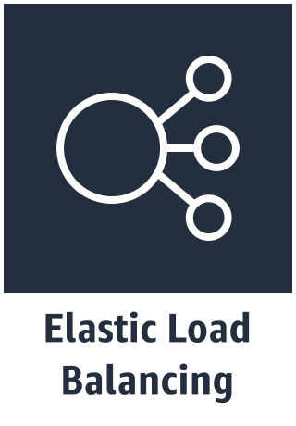
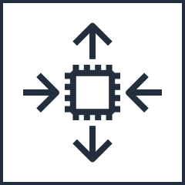
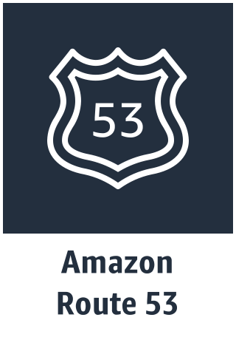
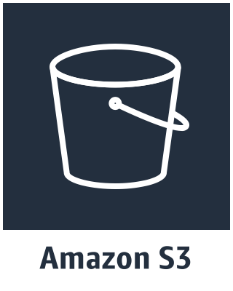
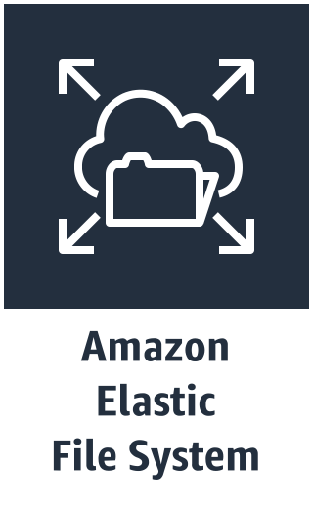
High Level VPC Reference Design
Cloud Region
Availability Zone A
Availability Zone B
Availability Zone C
Configure separate VPCs: One for each application environment.
Use all AZ in Cloud Region: Production in AZ-A, AZ-B (for HA/DR), Staging in AZ-B, and other Non-Production in AZ-C.
Configure a “Cold” DR Environment: DR images remain shutdown until are needed. No charges incurred (except storage) while images are shutdown.
Use automation for single zone HA: Production EC2s will auto configure when failure is detected.
Set up bastion/ Administration hosts: One on each VPC for administration activities.
Use NAT Gateways: Use for egress traffic from private subnets. One per VPC.
Production VPC
Production
Public Subnet 1
Public Subnet 1
Bastion
Bastion
Private Subnet 1
App
Private Subnet 1
App
Private Subnet 2
Datat
Private Subnet 2
Data
Public Subnet 1
Staging VPC
Bastion
Private Subnet 1
App
Private Subnet 2
Data
Non-Production VPC
Public Subnet 1
Bastion
Private Subnet 1
App
Private Subnet 2
Data
*
Shared Bastion server
* Not directly supported in GovCloud (outside ITAR boundary)
Notes:
V2
---keep separation
--non prod are also internet accessible and keep public/non-public subnets—ass separate Bastion to non prod.
---Bastion
--Webase console: port 444
---

